Slide 1
Econ 642: Week 3
Economic Growth Part 2

Slide 2
Economic Growth Part 2 Overview
Announcements
Discussion 3 Available
Problem Set 1 Due Next Week (12/17/2024)
After 12/17/2024 class, our next class is after the holiday break on 1/7/2025
Presentations Set 1 Tonight

Slide 3
Confronting Theory and Evidence
Kurlat Chapter 5

Slide 4
Confronting Theory and Evidence
Kaldor Facts Again
Putting Numbers on the Model
The Capital Accumulation Hypothesis
Growth Accounting
Where does total factor (or multifactor) differences come from?

Slide 5
The Kaldor Facts Again

Slide 6
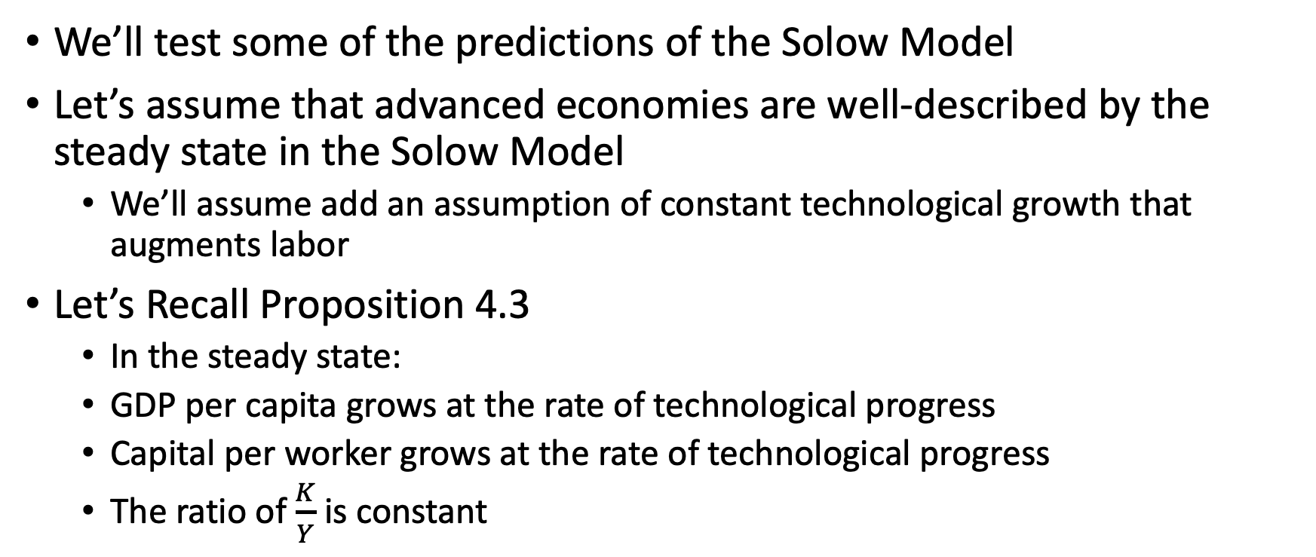
Kaldor Facts Again
We’ll test some of the predictions of the Solow Model
Let’s assume that advanced economies are well-described by the steady state in the Solow Model
We’ll assume add an assumption of constant technological growth that augments labor
Let’s Recall Proposition 4.3
In the steady state:
GDP per capita grows at the rate of technological progress
Capital per worker grows at the rate of technological progress
The ratio of $\frac{K}{Y}$ is constant

Slide 7
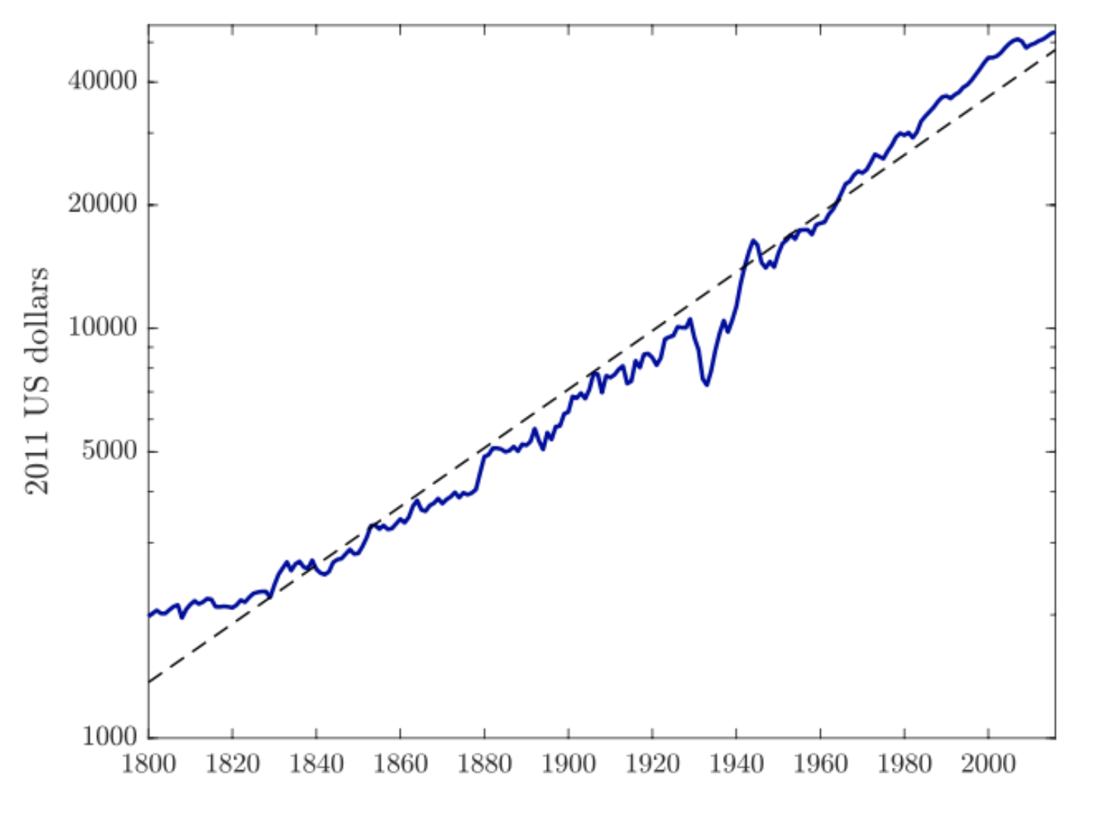
Kaldor Facts Again
Kaldor Fact 1:
The rate of growth of GDP per capita is constant
The Solow Model says that GDP per capita grows at the rate of technological progress
We are assuming constant technological progress, so it matches with Proposition 4.3 (even though this matches through assumption)

Slide 8
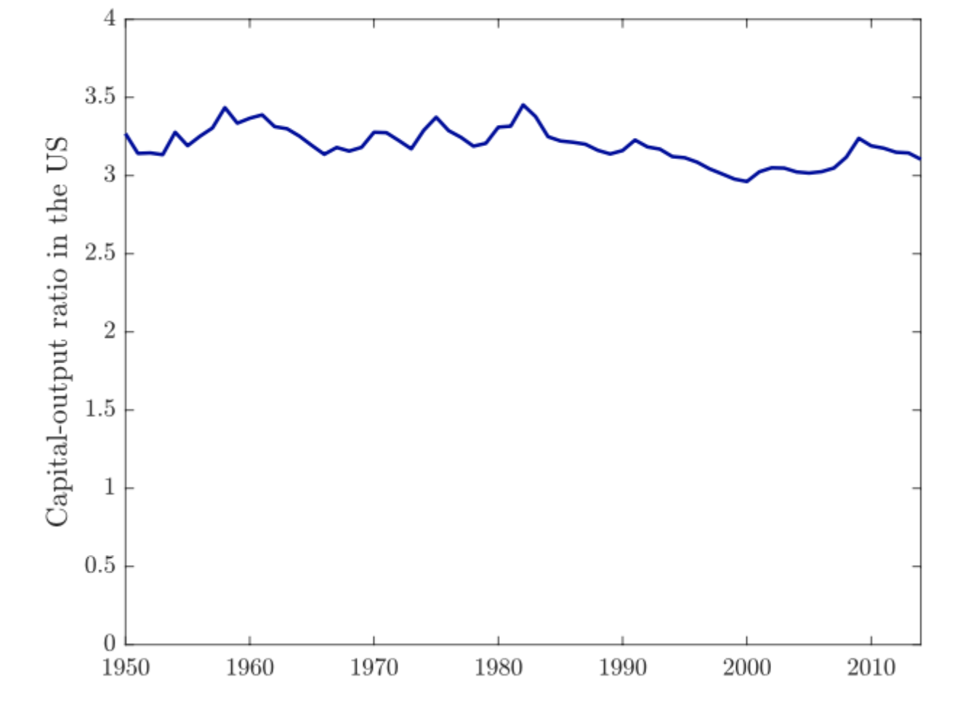
Kaldor Facts Again
Kaldor Fact 2:
The ratio of the total capital stock to GDP is constant
Under Proposition 4.3, we shows that the capital stock per output is constant
So part of the Solow Model better matches the data

Slide 9
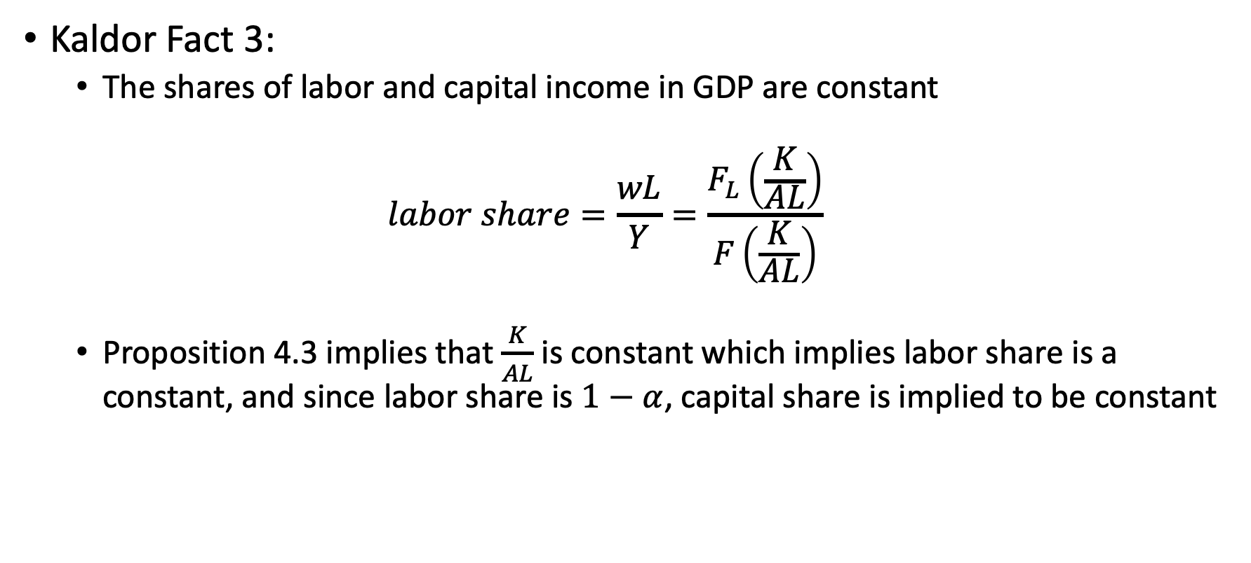
Kaldor Facts Again
Kaldor Fact 3:
The shares of labor and capital income in GDP are constant
$$labor share=\frac{wL}{Y}=\frac{F_{L}\left(\frac{K}{AL}\right)}{F\left(\frac{K}{AL}\right)}$$
Proposition 4.3 implies that $\frac{K}{AL}$ is constant which implies labor share is a constant, and since labor share is $1−α$, capital share is implied to be constant

Slide 10
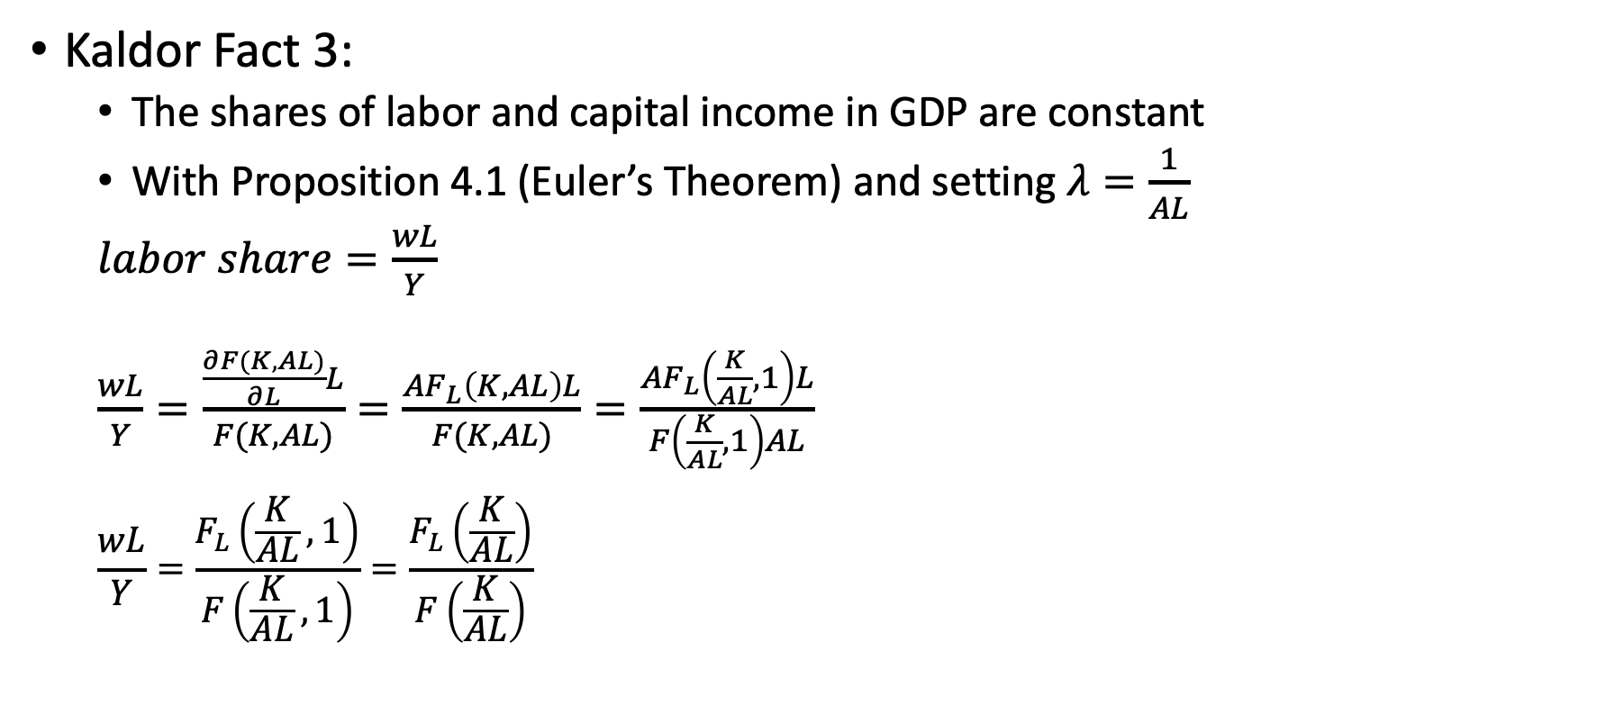
Kaldor Facts Again
Kaldor Fact 3:
The shares of labor and capital income in GDP are constant
With Proposition 4.1 (Euler’s Theorem) and setting $λ=\frac{1}{AL}$
$labor share=\frac{wL}{Y}$
$\frac{wL}{Y}=\frac{\frac{∂F(K,AL)}{∂L}L}{F(K,AL)}=\frac{AF_{L}\left(K,AL\right)L}{F(K,AL)}=\frac{AF_{L}\left(\frac{K}{AL},1\right)L}{F\left(\frac{K}{AL},1\right)AL}$
$$\frac{wL}{Y}=\frac{F_{L}\left(\frac{K}{AL},1\right)}{F\left(\frac{K}{AL},1\right)}=\frac{F_{L}\left(\frac{K}{AL}\right)}{F\left(\frac{K}{AL}\right)}$$

Slide 11
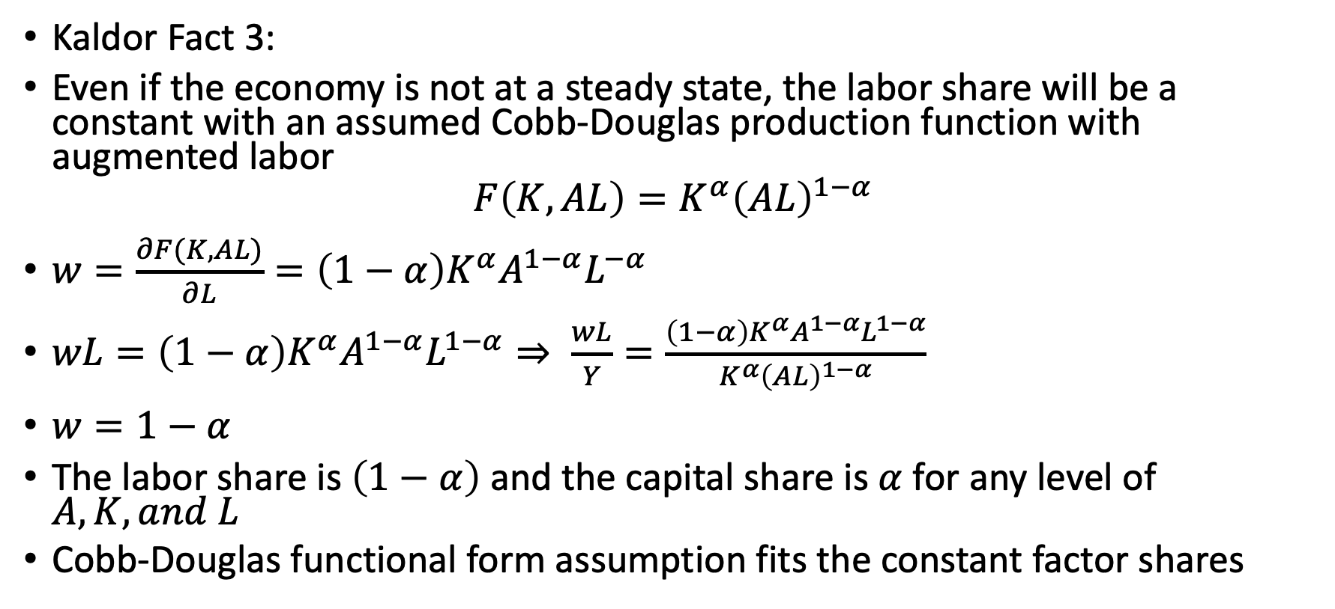
Kaldor Facts Again
Kaldor Fact 3:
Even if the economy is not at a steady state, the labor share will be a constant with an assumed Cobb-Douglas production function with augmented labor
$$F\left(K,AL\right)=K^{α}{\left(AL\right)}^{1−α}$$
$w=\frac{∂F(K,AL)}{∂L}=\left(1−α\right)K^{α}A^{1−α}L^{−α}$
$wL=\left(1−α\right)K^{α}A^{1−α}L^{1−α}⇒ \frac{wL}{Y}=\frac{\left(1−α\right)K^{α}A^{1−α}L^{1−α}}{K^{α}{\left(AL\right)}^{1−α}}$
$w=1−α$
The labor share is $\left(1−α\right)$ and the capital share is $α$ for any level of $A,K, and L$
Cobb-Douglas functional form assumption fits the constant factor shares

Slide 12
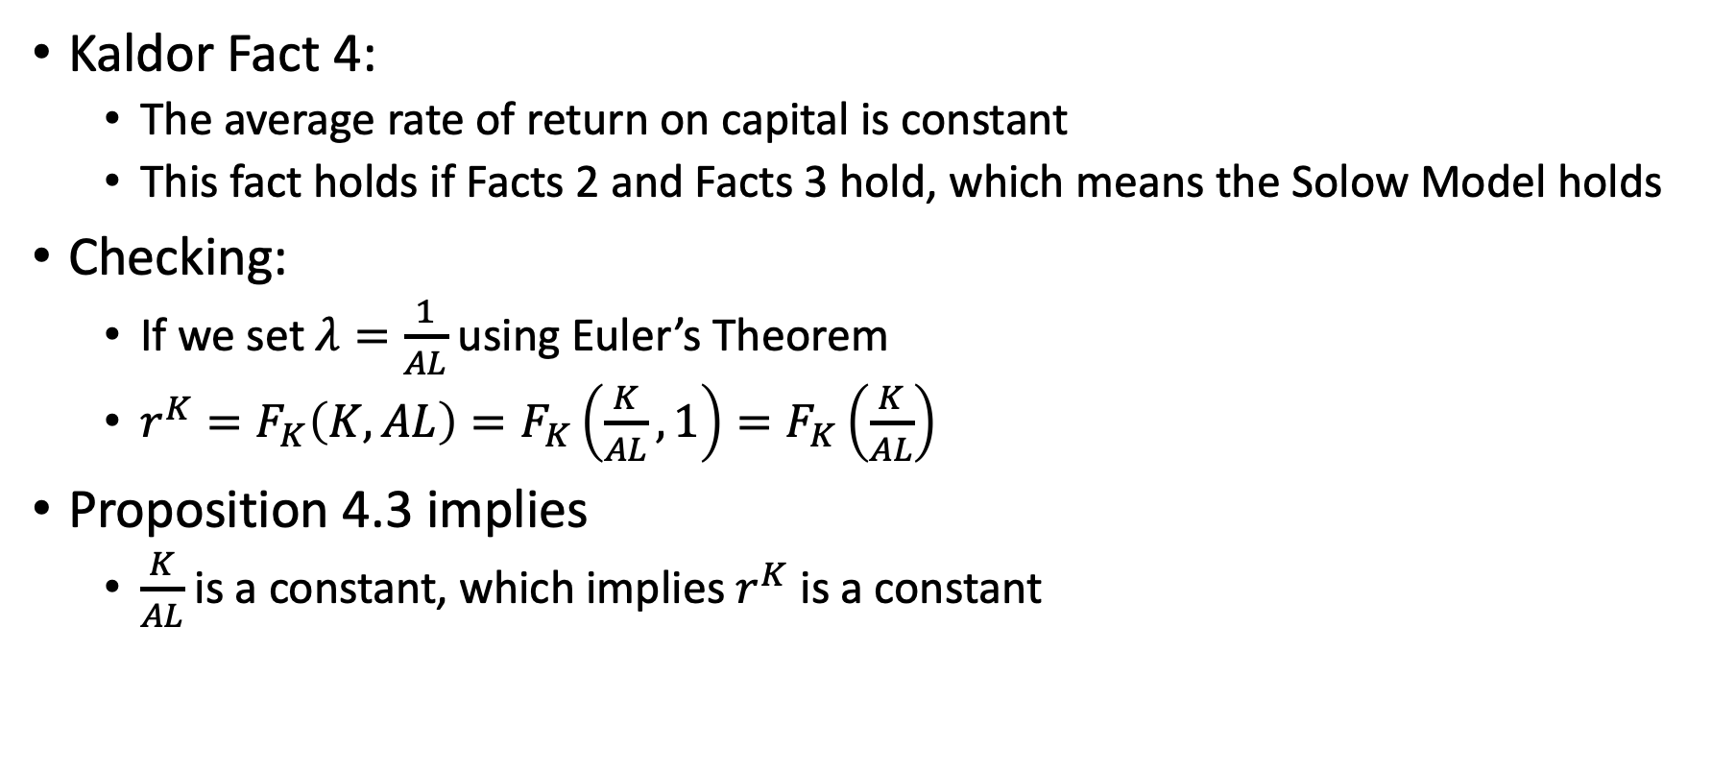
Kaldor Facts Again
Kaldor Fact 4:
The average rate of return on capital is constant
This fact holds if Facts 2 and Facts 3 hold, which means the Solow Model holds
Checking:
If we set $λ=\frac{1}{AL}$ using Euler’s Theorem
$r^{K}=F_{K}\left(K,AL\right)=F_{K}\left(\frac{K}{AL},1\right)=F_{K}\left(\frac{K}{AL}\right)$
Proposition 4.3 implies
$\frac{K}{AL}$ is a constant, which implies $r^{K}$ is a constant

Slide 13
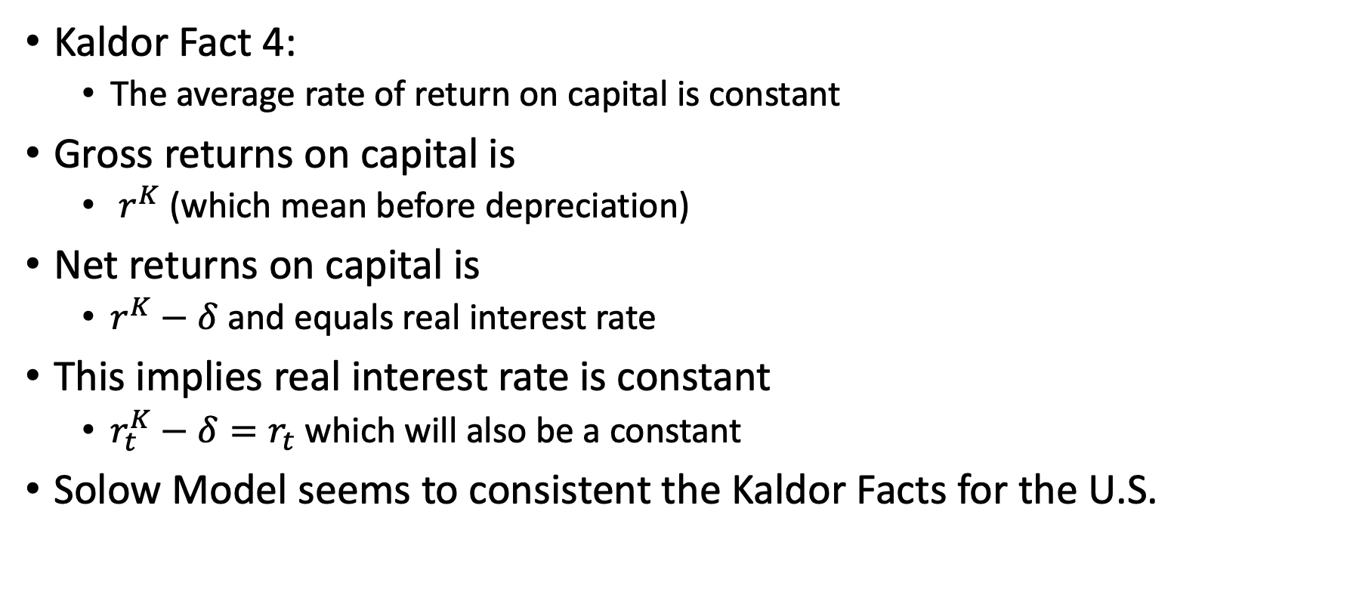
Kaldor Facts Again
Kaldor Fact 4:
The average rate of return on capital is constant
Gross returns on capital is
$r^{K}$ (which mean before depreciation)
Net returns on capital is
$r^{K}−δ$ and equals real interest rate
This implies real interest rate is constant
$r_{t}^{K}−δ=r_{t}$ which will also be a constant
Solow Model seems to consistent the Kaldor Facts for the U.S.

Slide 14
Putting the Numbers in the Model

Slide 15
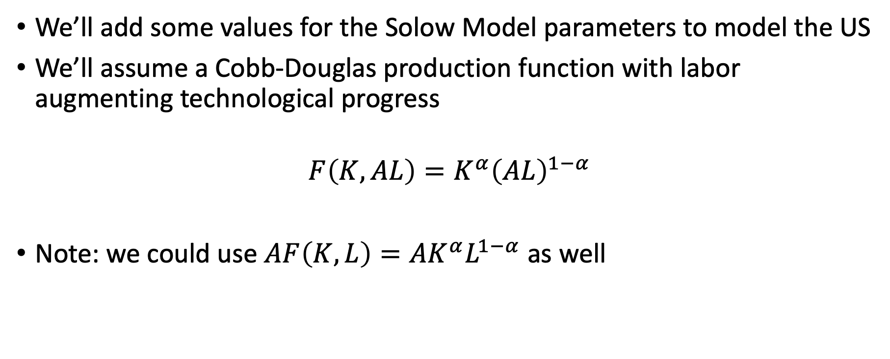
Putting Numbers in the Model
We’ll add some values for the Solow Model parameters to model the US
We’ll assume a Cobb-Douglas production function with labor augmenting technological progress
$$F\left(K,AL\right)=K^{α}{\left(AL\right)}^{1−α}$$
Note: we could use $AF\left(K,L\right)=AK^{α}L^{1−α}$ as well

Slide 16
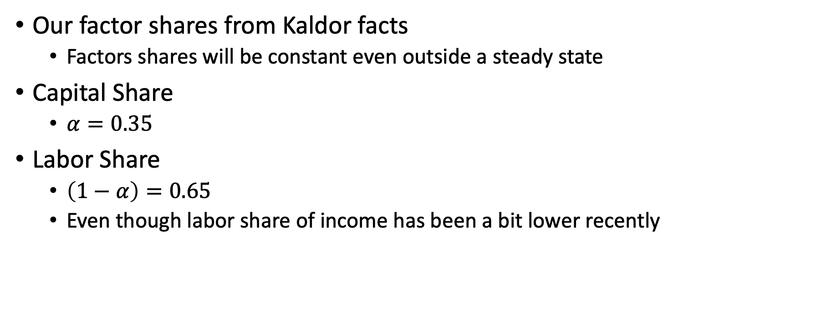
Putting Numbers in the Model
Our factor shares from Kaldor facts
Factors shares will be constant even outside a steady state
Capital Share
$α=0.35$
Labor Share
$\left(1−α\right)=0.65$
Even though labor share of income has been a bit lower recently

Slide 17
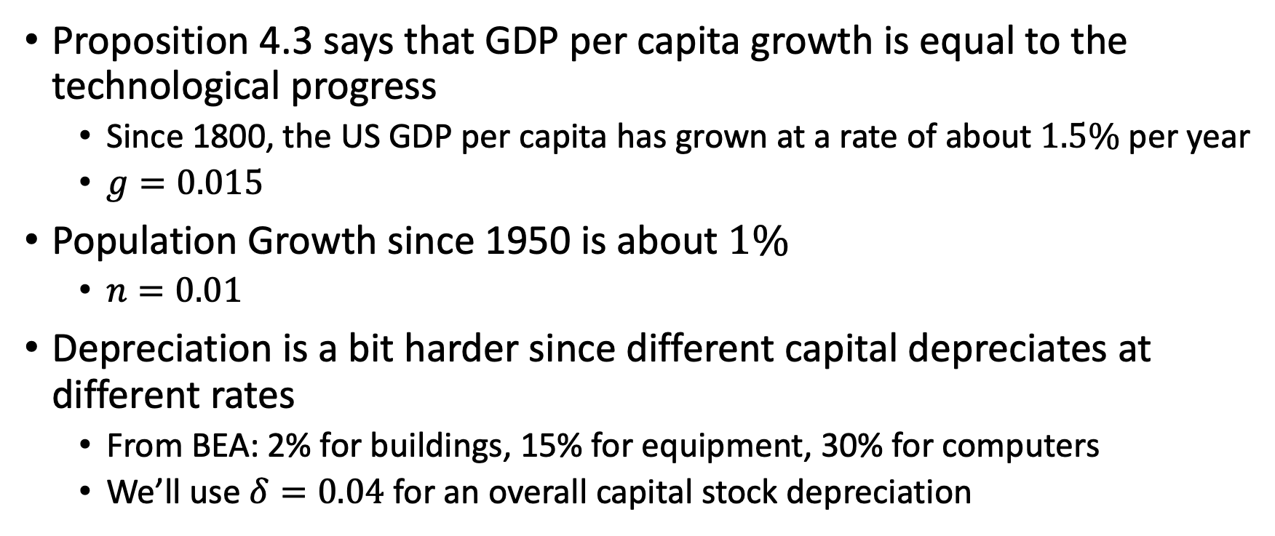
Putting Numbers in the Model
Proposition 4.3 says that GDP per capita growth is equal to the technological progress
Since 1800, the US GDP per capita has grown at a rate of about $1.5\%$ per year
$g=0.015$
Population Growth since 1950 is about $1\%$
$n=0.01$
Depreciation is a bit harder since different capital depreciates at different rates
From BEA: 2% for buildings, 15% for equipment, 30% for computers
We’ll use $δ=0.04$ for an overall capital stock depreciation

Slide 18
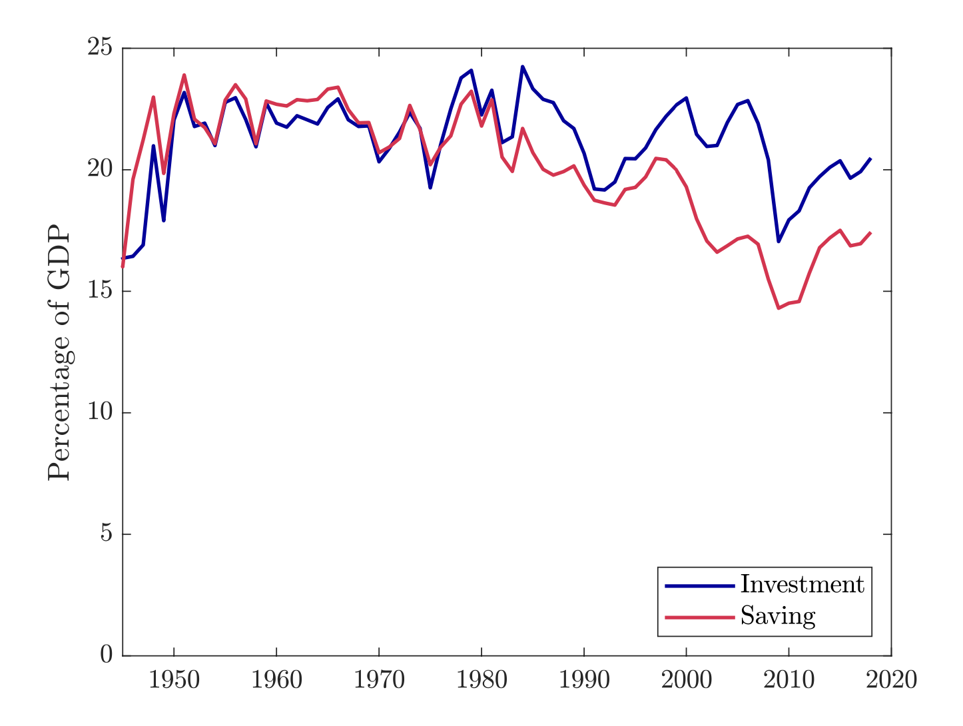
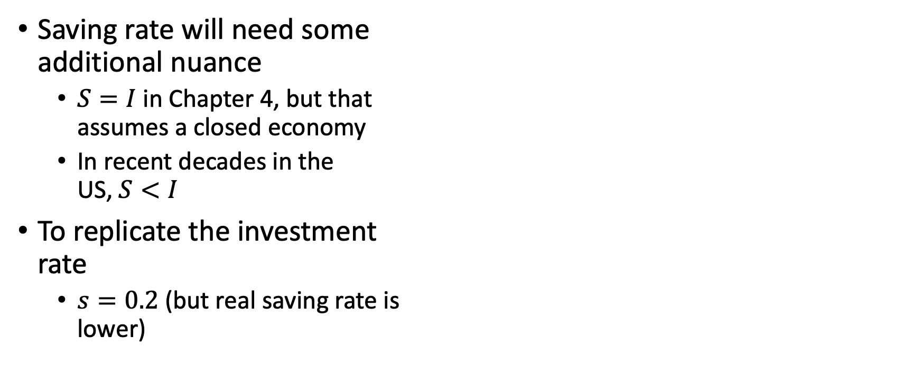
Putting Numbers in the Model
Saving rate will need some additional nuance
$S=I$ in Chapter 4, but that assumes a closed economy
In recent decades in the US, $S<I$
To replicate the investment rate
$s=0.2$ (but real saving rate is lower)

Slide 19
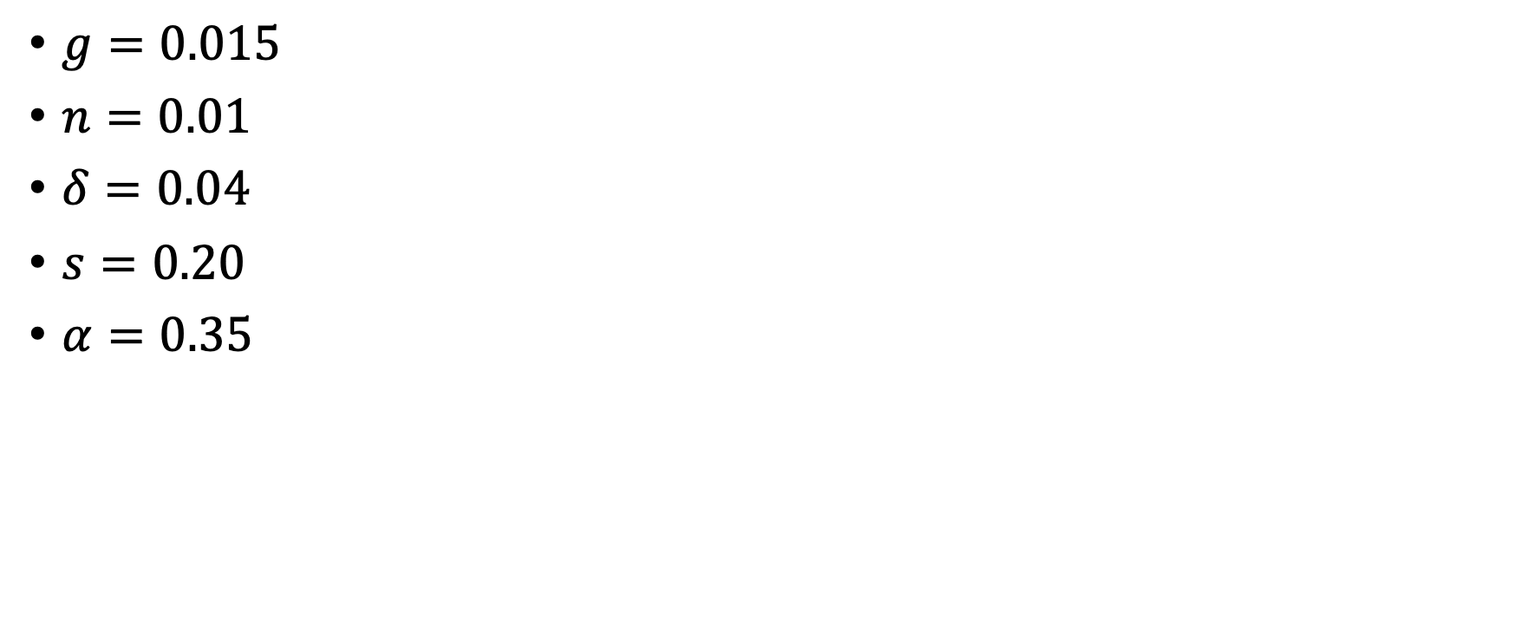
Putting Numbers in the Model
$g=0.015$
$n=0.01$
$δ=0.04$
$s=0.20$
$α=0.35$

Slide 20
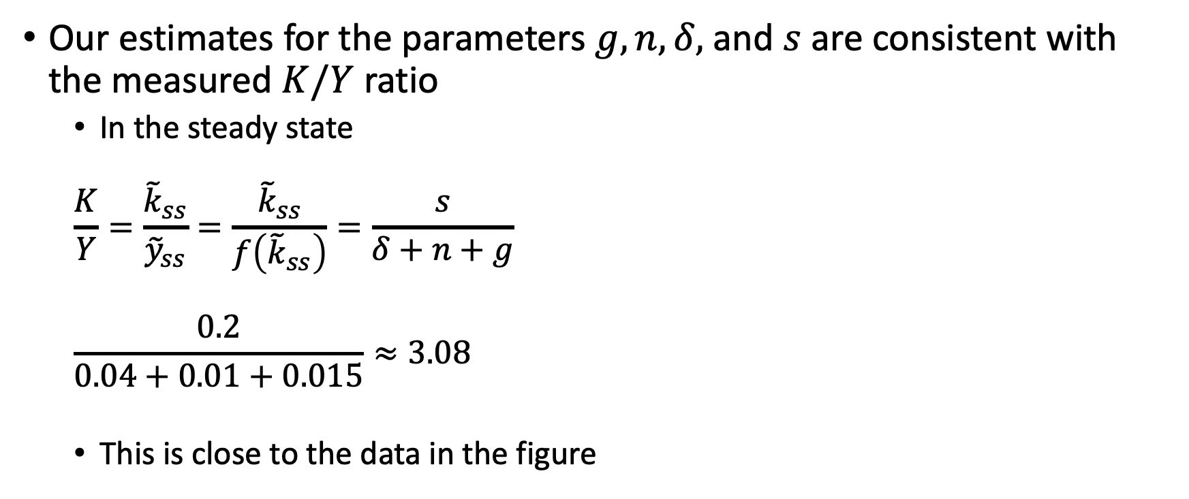
Putting Numbers in the Model
Our estimates for the parameters $g, n, δ,$ and $s$ are consistent with the measured $K/Y$ ratio
In the steady state
$$\frac{K}{Y}=\frac{{\tilde{k}}_{ss}}{{\tilde{y}}_{ss}}=\frac{{\tilde{k}}_{ss}}{f\left({\tilde{k}}_{ss}\right)}=\frac{s}{δ+n+g}$$
$$\frac{0.2}{0.04+0.01+0.015}≈3.08$$
This is close to the data in the figure

Slide 21
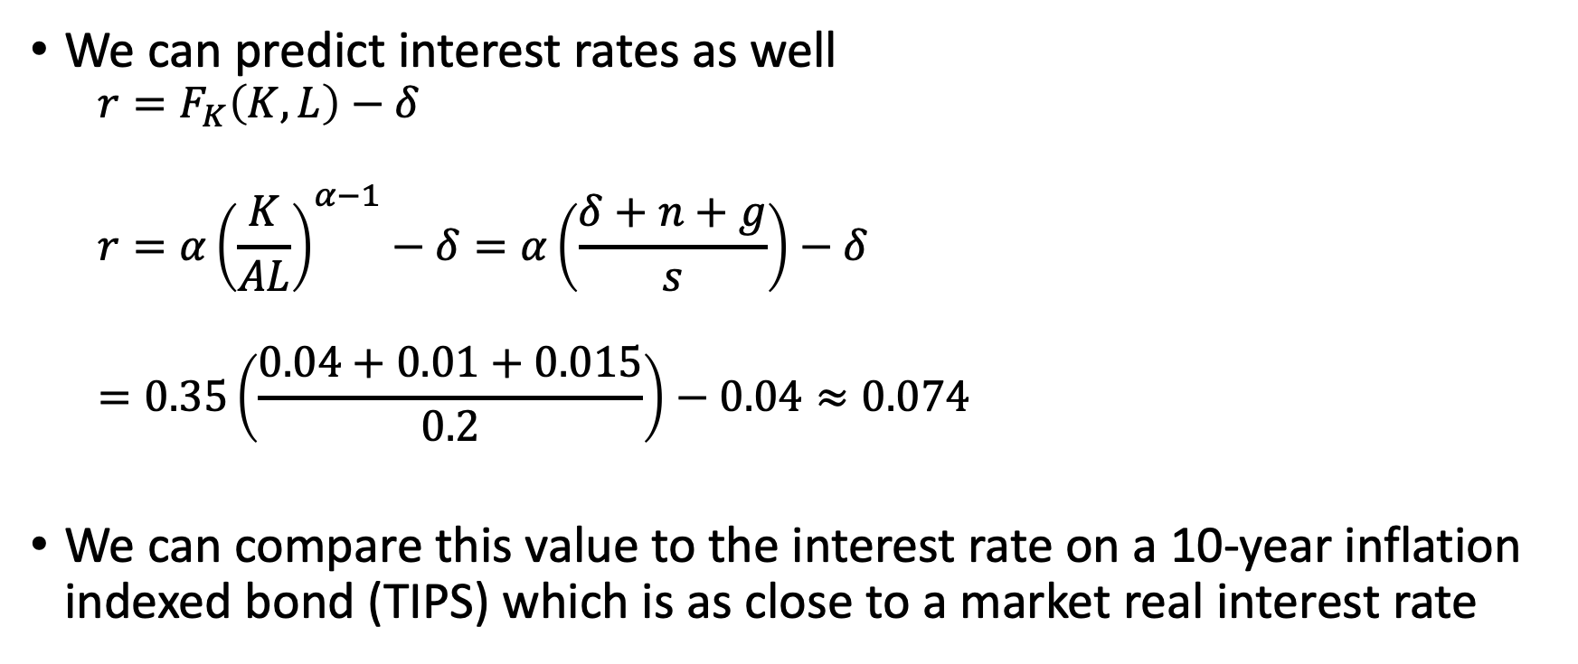
Putting Numbers in the Model
We can predict interest rates as well
$$r=F_{K}\left(K,L\right)−δ$$
$$r=α{\left(\frac{K}{AL}\right)}^{α−1}−δ=α\left(\frac{δ+n+g}{s}\right)−δ$$ $$=0.35\left(\frac{0.04+0.01+0.015}{0.2}\right)−0.04≈0.074$$
We can compare this value to the interest rate on a 10-year inflation indexed bond (TIPS) which is as close to a market real interest rate

Slide 22
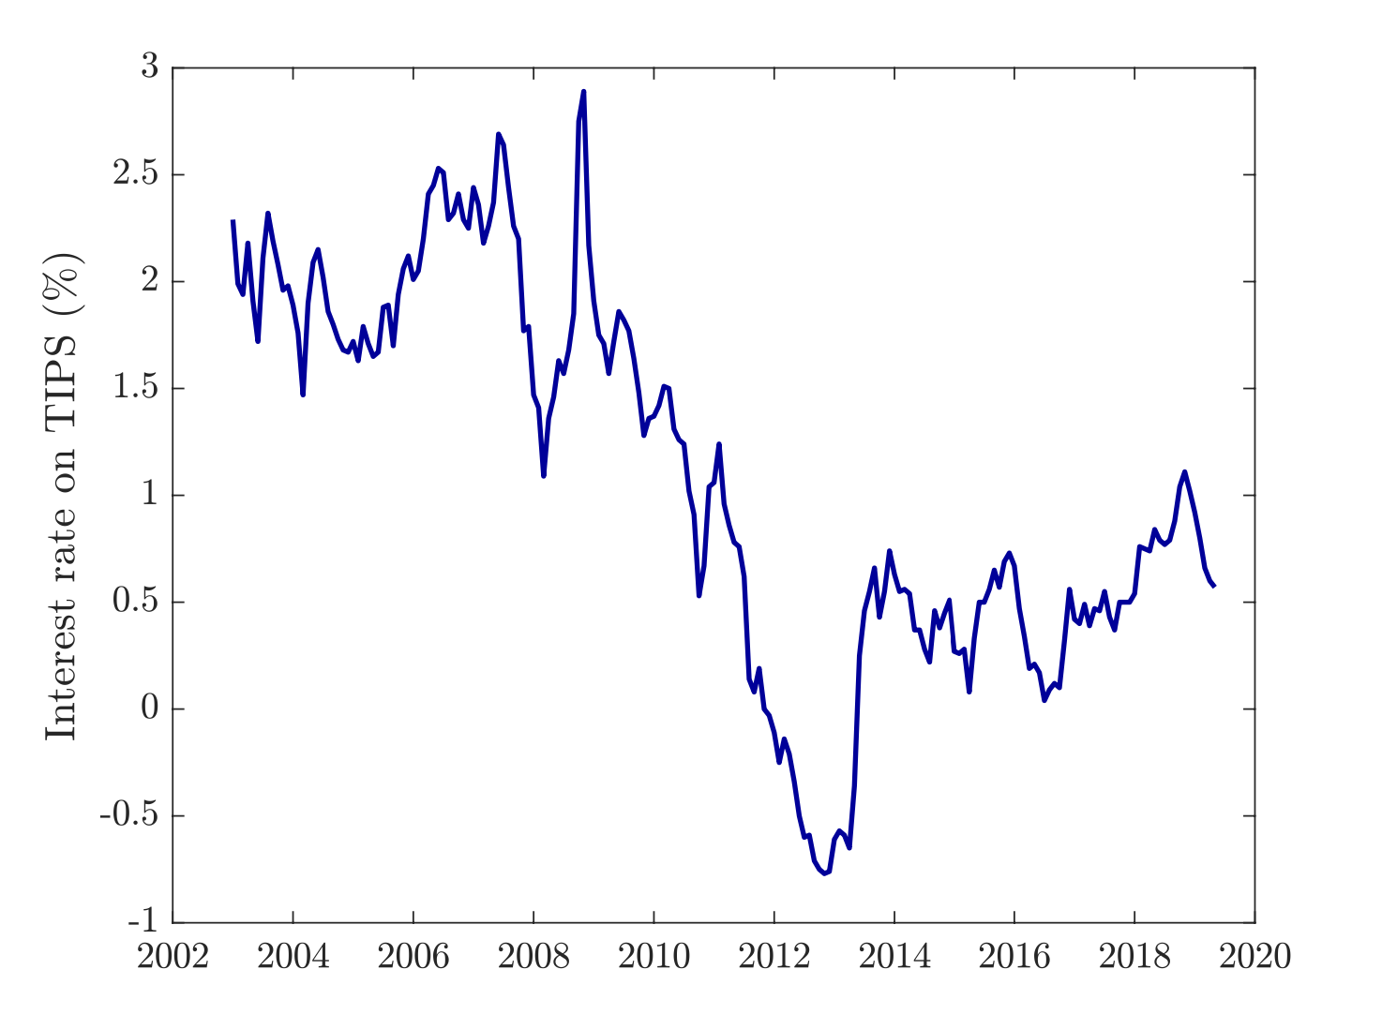
Putting Numbers in the Model
Using TIPS, we can see that the returns have closer to 1% or 2% clearly below our predicted 7.4%
One source of difference could be risk – TIPS are very safe
The average real return on the S&P 500 index between 1929 and 2018 was 7.8%, which is closer to our model

Slide 23
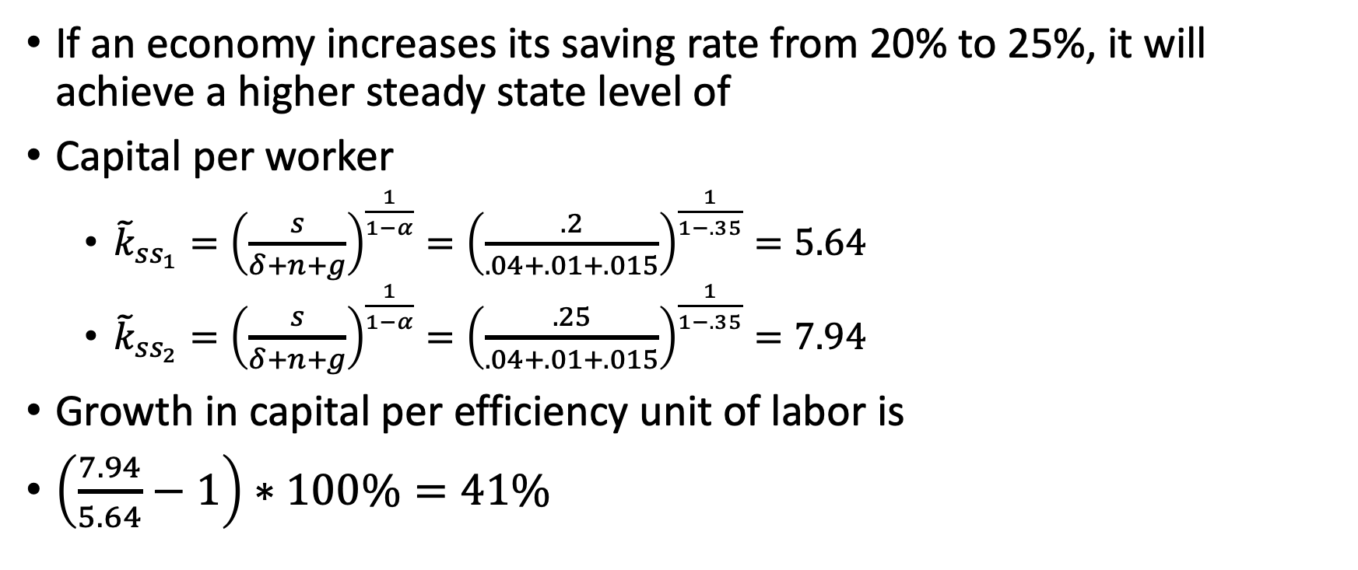
Putting Numbers in the Model
If an economy increases its saving rate from 20% to 25%, it will achieve a higher steady state level of
Capital per worker
${\tilde{k}}_{ss_{1}}={\left(\frac{s}{δ+n+g}\right)}^{\frac{1}{1−α}}={\left(\frac{.2}{.04+.01+.015}\right)}^{\frac{1}{1−.35}}=5.64$
${\tilde{k}}_{ss_{2}}={\left(\frac{s}{δ+n+g}\right)}^{\frac{1}{1−α}}={\left(\frac{.25}{.04+.01+.015}\right)}^{\frac{1}{1−.35}}=7.94$
Growth in capital per efficiency unit of labor is
$\left(\frac{7.94}{5.64}−1\right)∗100\%=41\%$

Slide 24
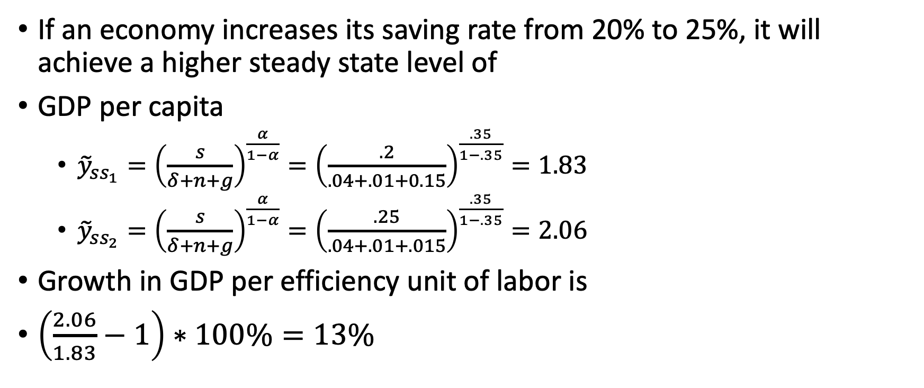
Putting Numbers in the Model
If an economy increases its saving rate from 20% to 25%, it will achieve a higher steady state level of
GDP per capita
${\tilde{y}}_{ss_{1}}={\left(\frac{s}{δ+n+g}\right)}^{\frac{α}{1−α}}={\left(\frac{.2}{.04+.01+0.15}\right)}^{\frac{.35}{1−.35}}=1.83$
${\tilde{y}}_{ss_{2}}={\left(\frac{s}{δ+n+g}\right)}^{\frac{α}{1−α}}={\left(\frac{.25}{.04+.01+.015}\right)}^{\frac{.35}{1−.35}}=2.06$
Growth in GDP per efficiency unit of labor is
$\left(\frac{2.06}{1.83}−1\right)∗100\%=13\%$

Slide 25
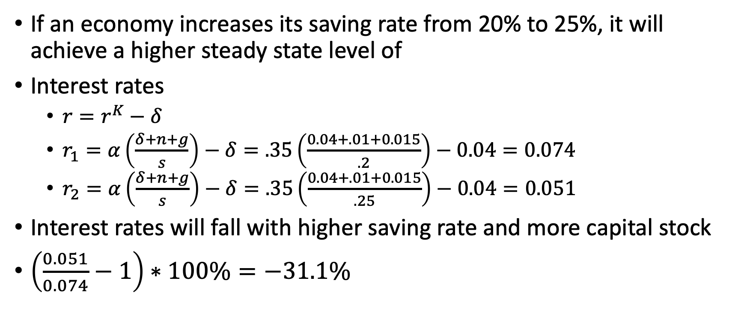
Putting Numbers in the Model
If an economy increases its saving rate from 20% to 25%, it will achieve a higher steady state level of
Interest rates
$r=r^{K}−δ$
$r_{1}=α\left(\frac{δ+n+g}{s}\right)−δ=.35\left(\frac{0.04+.01+0.015}{.2}\right)−0.04=0.074$
$r_{2}=α\left(\frac{δ+n+g}{s}\right)−δ=.35\left(\frac{0.04+.01+0.015}{.25}\right)−0.04=0.051$
Interest rates will fall with higher saving rate and more capital stock
$\left(\frac{0.051}{0.074}−1\right)∗100\%=−31.1\%$

Slide 26
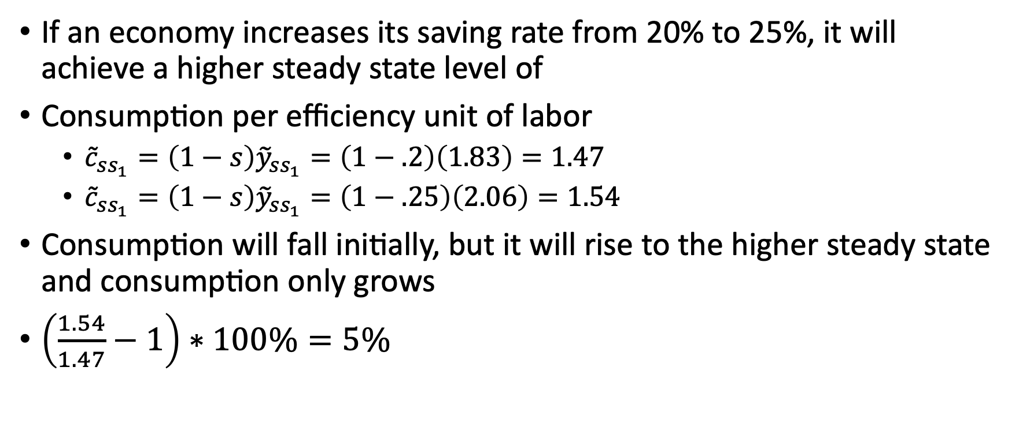
Putting Numbers in the Model
If an economy increases its saving rate from 20% to 25%, it will achieve a higher steady state level of
Consumption per efficiency unit of labor
${\tilde{c}}_{ss_{1}}=\left(1−s\right){\tilde{y}}_{ss_{1}}=\left(1−.2\right)\left(1.83\right)=1.47$
${\tilde{c}}_{ss_{1}}=\left(1−s\right){\tilde{y}}_{ss_{1}}=\left(1−.25\right)\left(2.06\right)=1.54$
Consumption will fall initially, but it will rise to the higher steady state and consumption only grows
$\left(\frac{1.54}{1.47}−1\right)∗100\%=5\%$

Slide 27
The Capital Accumulation Hypothesis

Slide 28
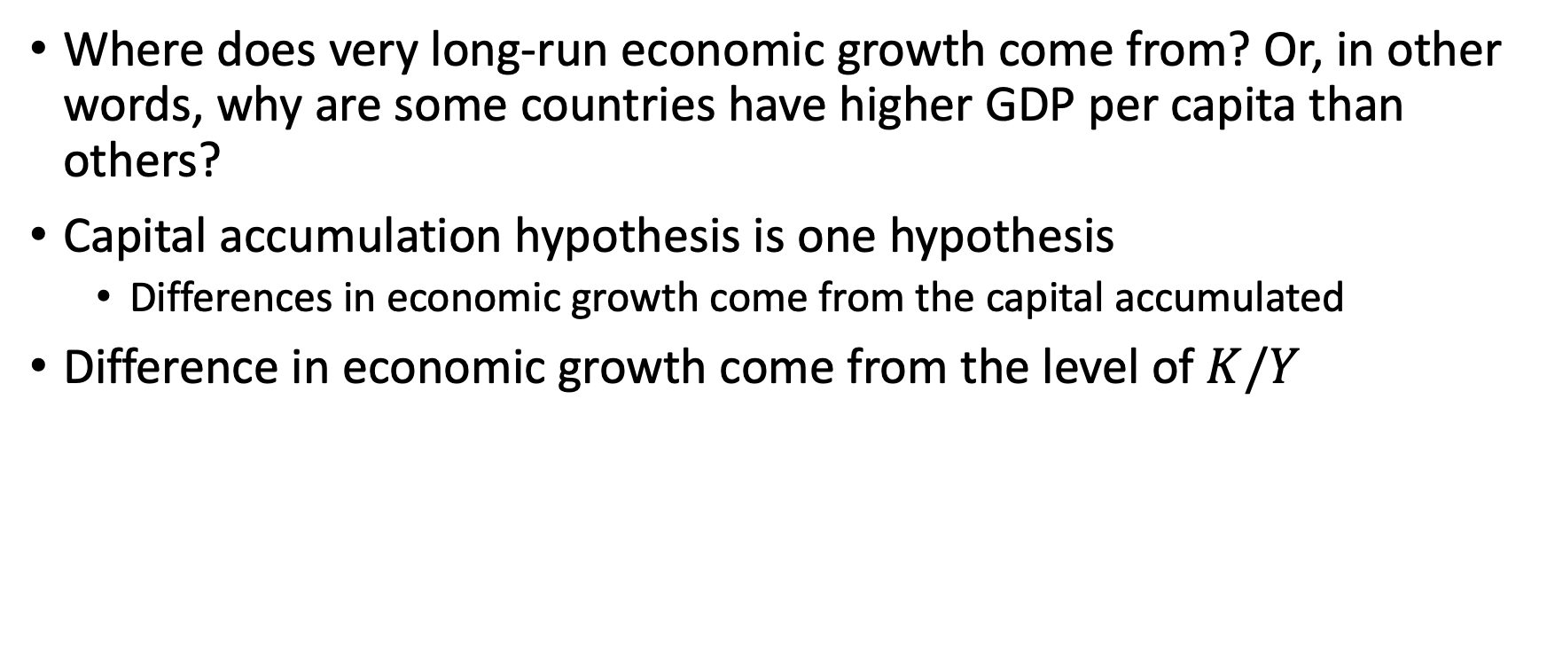
Capital Accumulation Hypothesis
Where does very long-run economic growth come from? Or, in other words, why are some countries have higher GDP per capita than others?
Capital accumulation hypothesis is one hypothesis
Differences in economic growth come from the capital accumulated
Difference in economic growth come from the level of $K/Y$

Slide 29
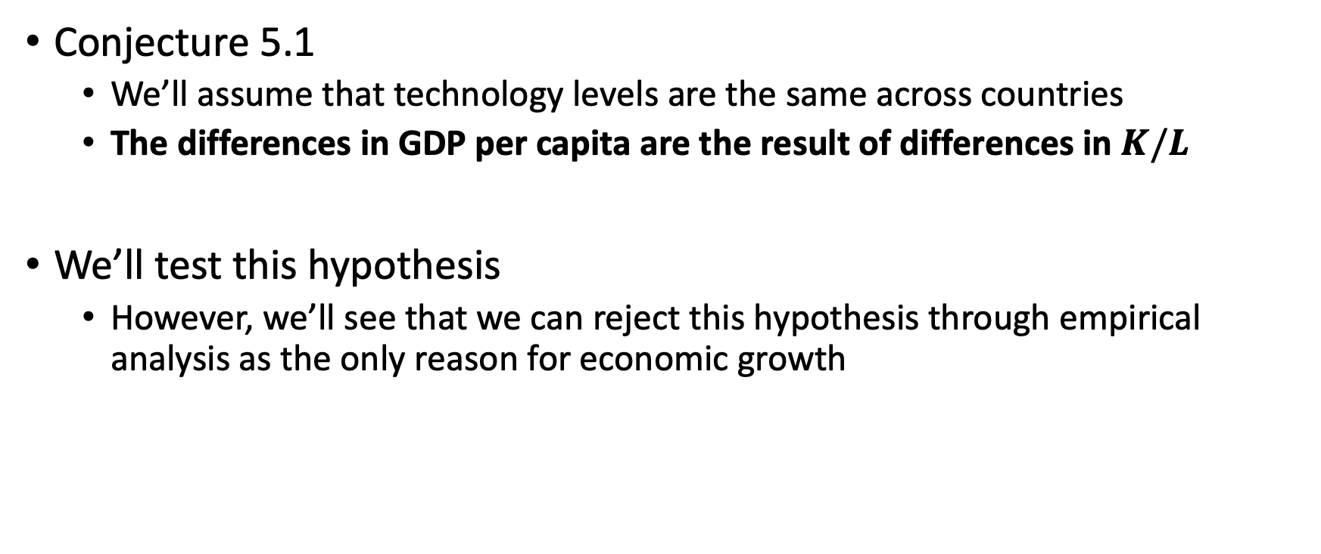
Capital Accumulation Hypothesis
Conjecture 5.1
We’ll assume that technology levels are the same across countries
The differences in GDP per capita are the result of differences in $K/L$
We’ll test this hypothesis
However, we’ll see that we can reject this hypothesis through empirical analysis as the only reason for economic growth

Slide 30
Capital Accumulation Hypothesis
Looking for evidence for the capital accumulation hypothesis using three different approaches
We’ll look at:
Convergence
Direct Measurement of capital stock
Interest rates and capital flows

Slide 31
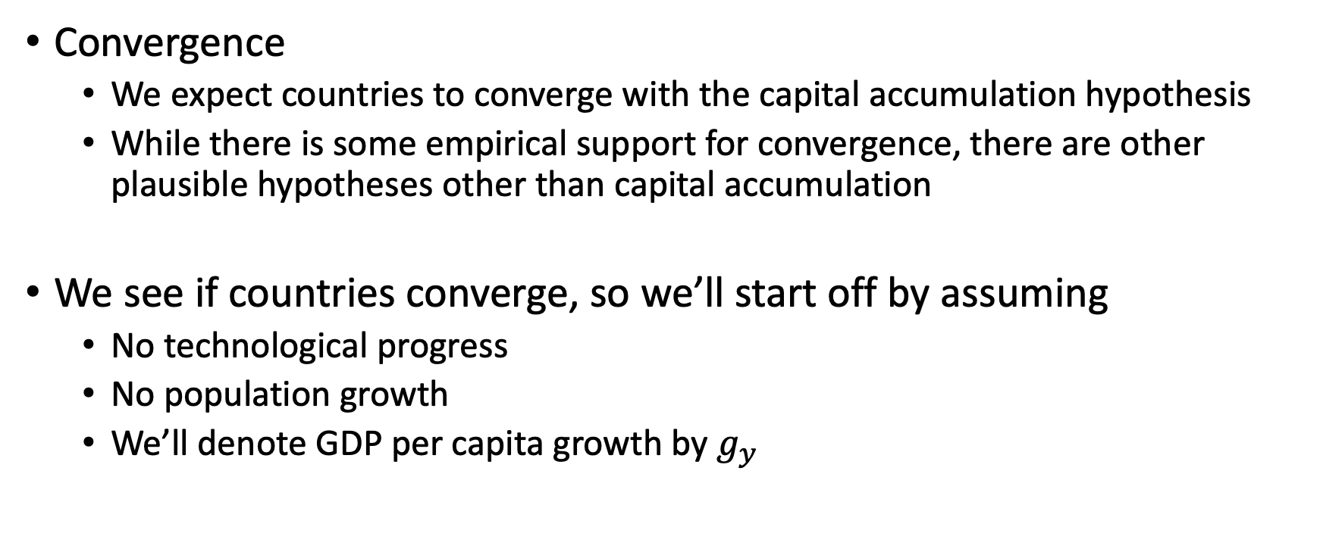
Capital Accumulation Hypothesis: Convergence
Convergence
We expect countries to converge with the capital accumulation hypothesis
While there is some empirical support for convergence, there are other plausible hypotheses other than capital accumulation
We see if countries converge, so we’ll start off by assuming
No technological progress
No population growth
We’ll denote GDP per capita growth by $g_{y}$

Slide 32
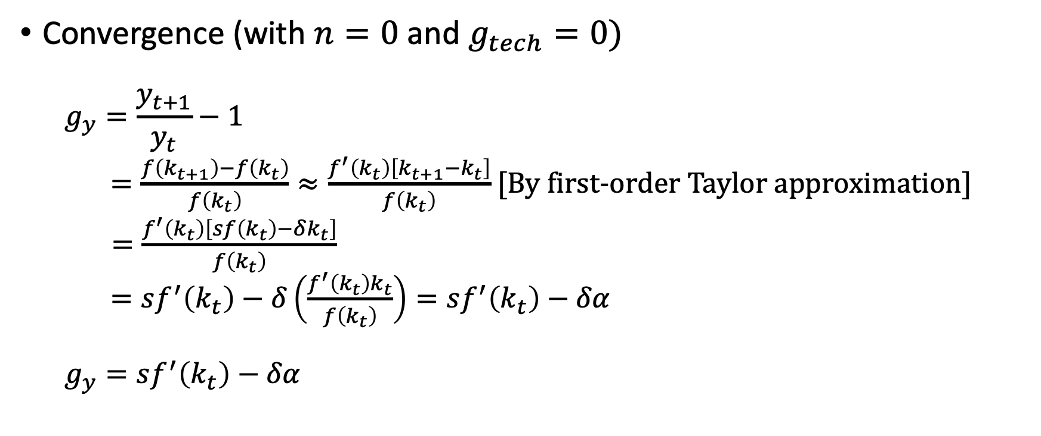
Capital Accumulation Hypothesis: Convergence
Convergence (with $n=0$ and $g_{tech}=0)$
$$g_{y}=\frac{y_{t+1}}{y_{t}}−1$$ $=\frac{f\left(k_{t+1}\right)−f\left(k_{t}\right)}{f\left(k_{t}\right)}≈\frac{f^{′}\left(k_{t}\right)\left[k_{t+1}−k_{t}\right]}{f\left(k_{t}\right)}$ [By first-order Taylor approximation]
$=\frac{f^{′}\left(k_{t}\right)\left[sf\left(k_{t}\right)−δk_{t}\right]}{f\left(k_{t}\right)}$ $=sf^{′}\left(k_{t}\right)−δ\left(\frac{f^{′}\left(k_{t}\right)k_{t}}{f\left(k_{t}\right)}\right)=sf^{′}\left(k_{t}\right)−δα$ $$g_{y}=sf^{′}\left(k_{t}\right)−δα$$

Slide 33
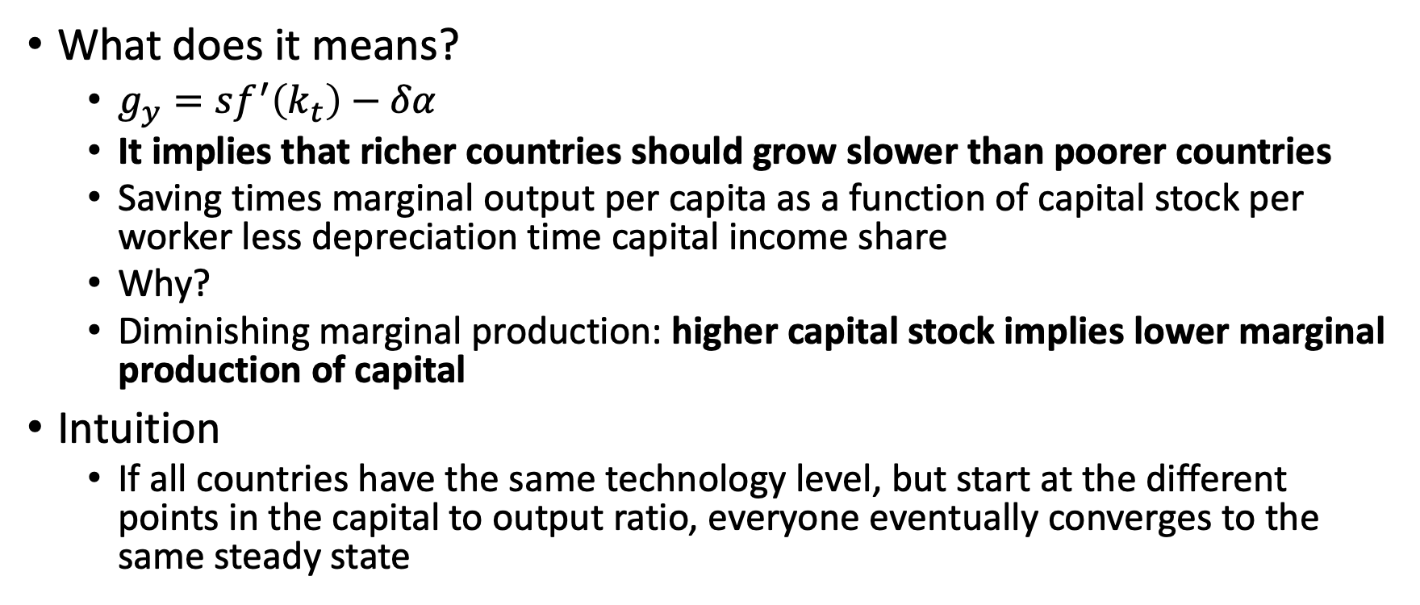
Capital Accumulation Hypothesis: Convergence
What does it means?
$g_{y}=sf^{′}\left(k_{t}\right)−δα$
It implies that richer countries should grow slower than poorer countries
Saving times marginal output per capita as a function of capital stock per worker less depreciation time capital income share
Why?
Diminishing marginal production: higher capital stock implies lower marginal production of capital
Intuition
If all countries have the same technology level, but start at the different points in the capital to output ratio, everyone eventually converges to the same steady state

Slide 34
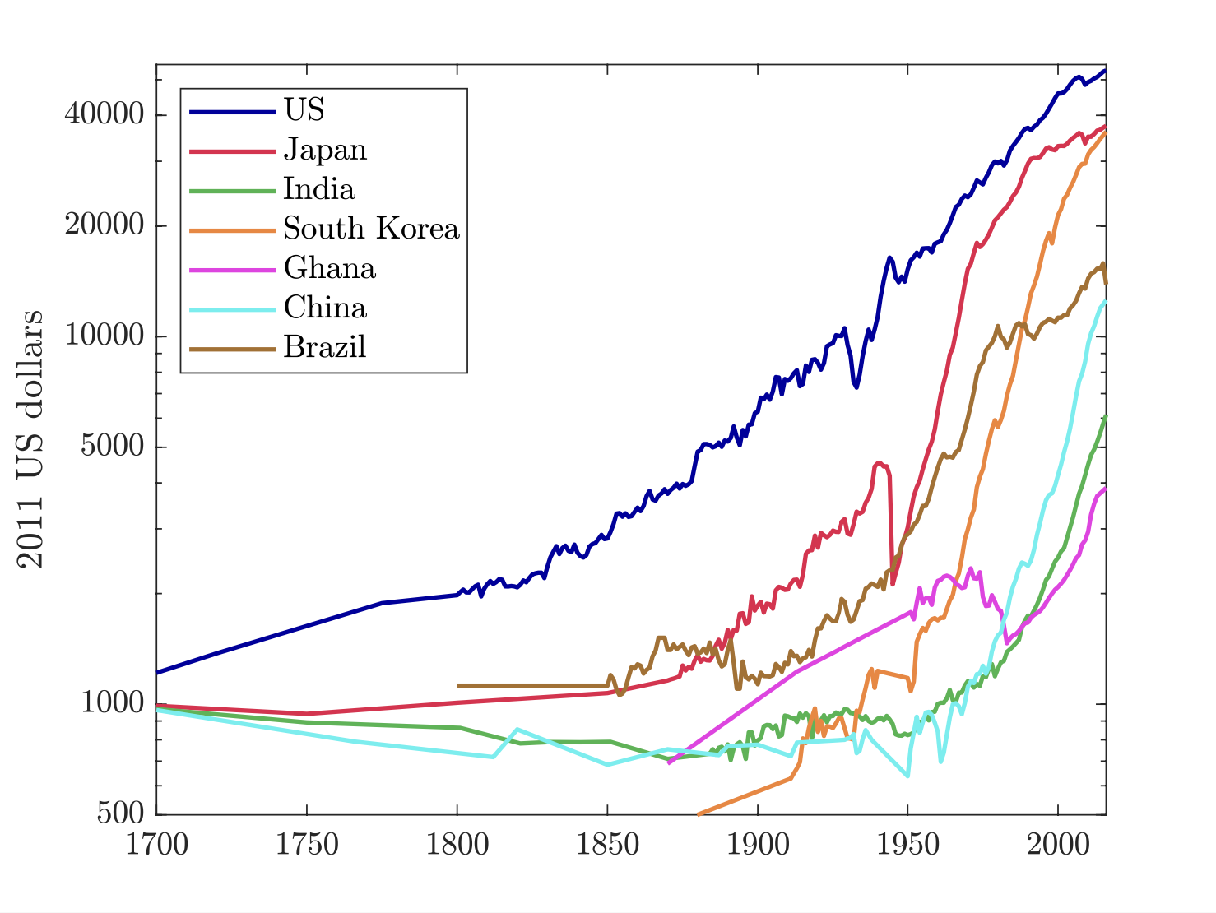
Capital Accumulation Hypothesis: Convergence
We can test this with some empirical data.
If the capital accumulation hypothesis were accurate, then initially poor countries should grow faster than initially rich countries
We don’t see too much evidence in the time series

Slide 35
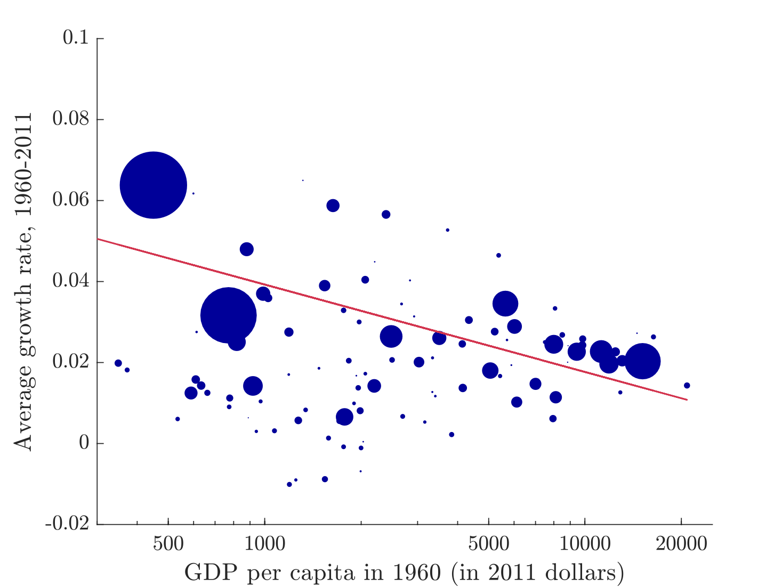
Capital Accumulation Hypothesis: Convergence
When we look at cross- sections at points in time, we do see some evidence of convergence
We also can add population weights to GDP per capita and growth rates
Here is a cross-section of GDP per capita and growth rates with population weights in 1960

Slide 36
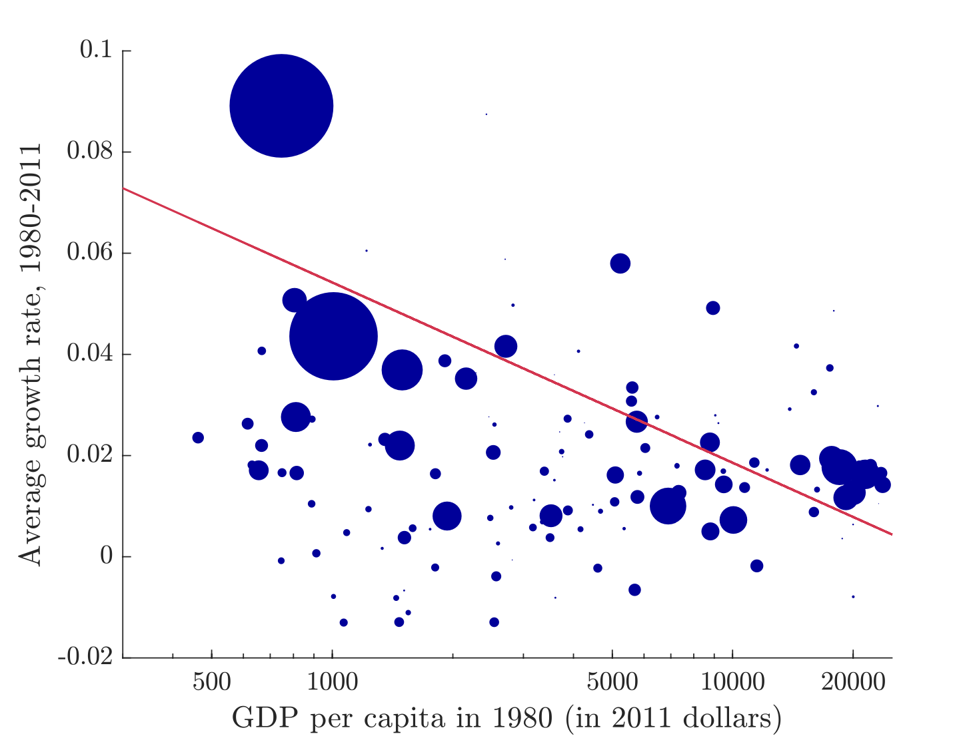
Capital Accumulation Hypothesis: Convergence
The convergence hypothesis is a bit stronger in the 1980 cross-section
India and China start off with low GDP per capita, but experienced very high growth rates
Given their populations, they skew the negative correlation
There could be other reasons for their convergence, but we cannot rule out capital accumulation yet

Slide 37
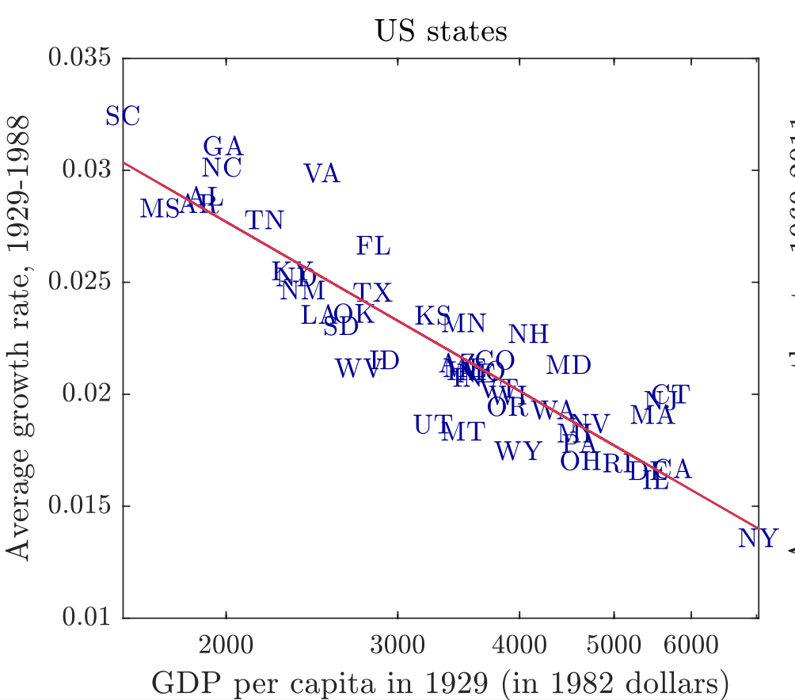
Capital Accumulation Hypothesis: Convergence
Maybe the capital accumulation holds true within countries
Southern states were a lot poorer in early 20th century
The capital accumulation hypothesis could have explained why Maryland was richer than Georgia, or why Ohio was richer than Tennessee
This may be true even if the capital accumulation hypothesis does not explain why the US has higher GDP per capita than Paraguay

Slide 38
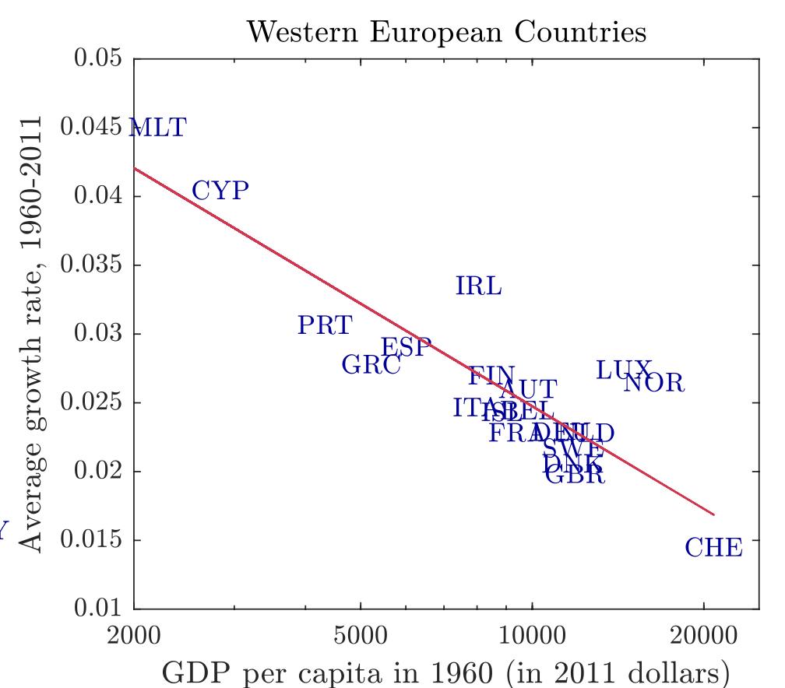
Capital Accumulation Hypothesis: Convergence
We notice a similar trend in GDP per capita and growth rates within Europe
Just becomes with find some evidence that supports the capital accumulation hypothesis does not mean we have causal inference
Limited evidence for convergence with capital accumulation hypothesis but there could be other reasons for growth

Slide 39
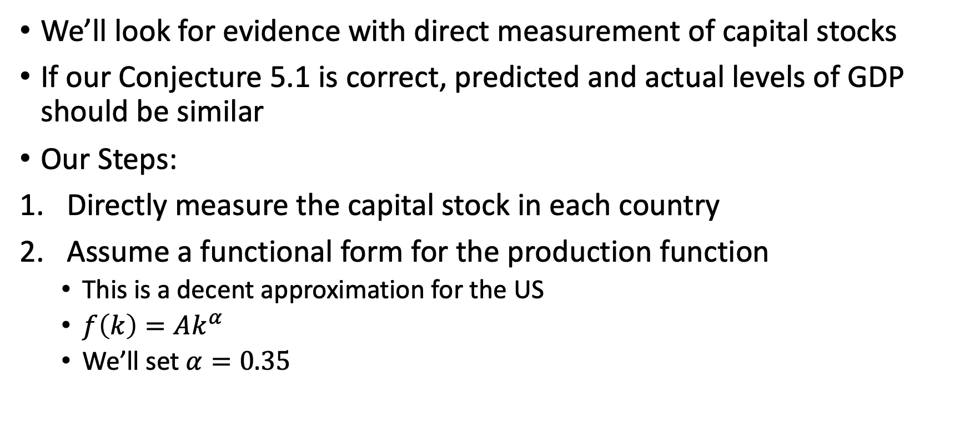
Capital Accumulation Hypothesis: Direct Measurement
We’ll look for evidence with direct measurement of capital stocks
If our Conjecture 5.1 is correct, predicted and actual levels of GDP should be similar
Our Steps:
Directly measure the capital stock in each country
Assume a functional form for the production function
This is a decent approximation for the US
$f\left(k\right)=Ak^{α}$
We’ll set $α=0.35$

Slide 40
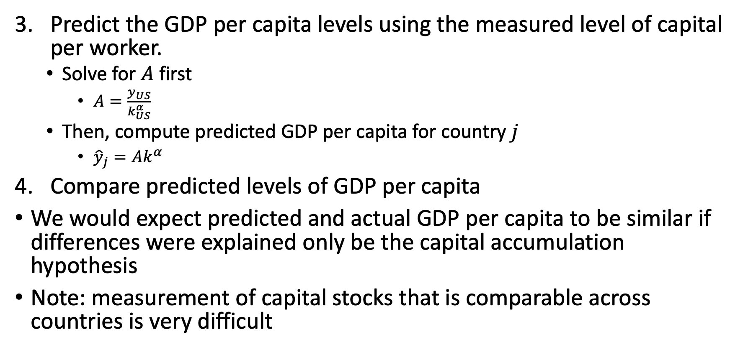
Capital Accumulation Hypothesis: Direct Measurement
Predict the GDP per capita levels using the measured level of capital per worker.
Solve for $A$ first
$A=\frac{y_{US}}{k_{US}^{α}}$
Then, compute predicted GDP per capita for country $j$
${\hat{y}}_{j}=Ak^{α}$
Compare predicted levels of GDP per capita
We would expect predicted and actual GDP per capita to be similar if differences were explained only be the capital accumulation hypothesis
Note: measurement of capital stocks that is comparable across countries is very difficult

Slide 41
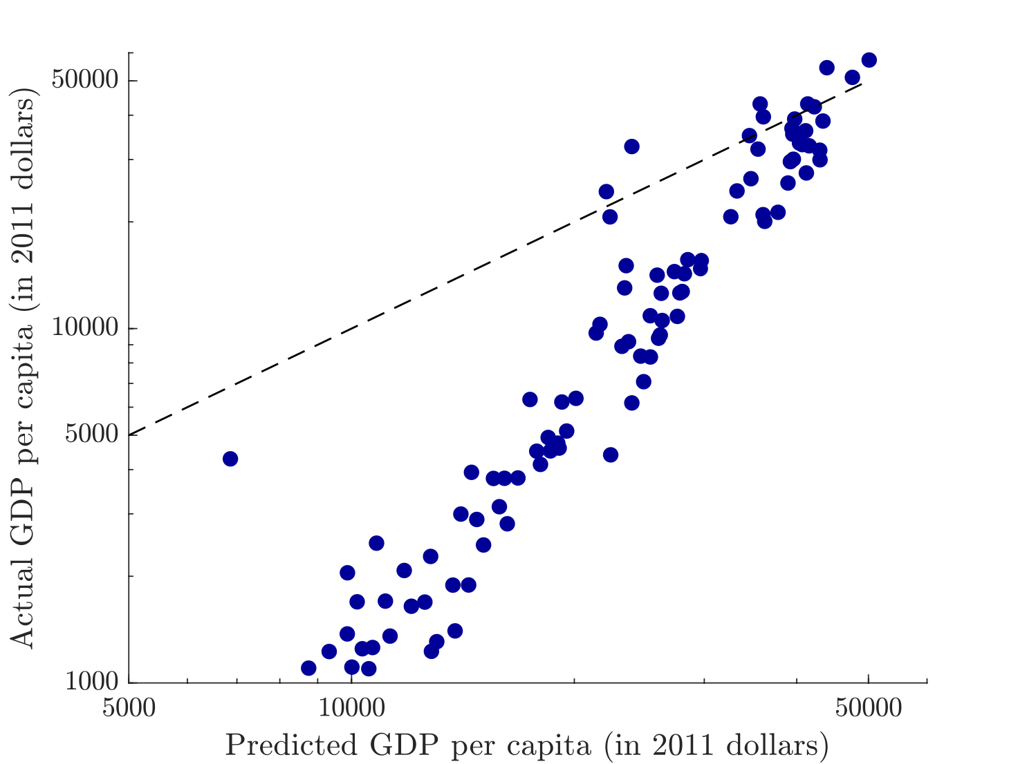
Capital Accumulation Hypothesis: Direct Measurement
For countries with lower GDP per capita, this model does poorly and it gets worse as actual GDP per capita declines
If it is only capital accumulation, then poor countries should have a GDP around $10,000 not $1,000
If anything, this is evidence against assuming similar production functions and technology levels

Slide 42
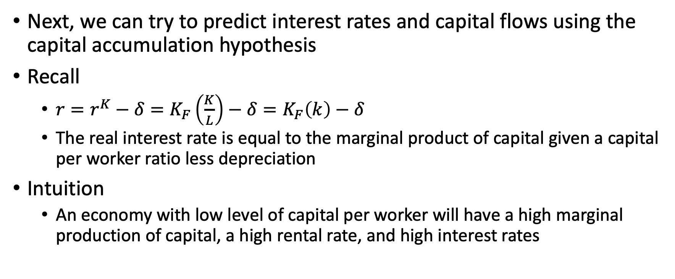
Capital Accumulation Hypothesis: Interest Rates and Capital Flows
Next, we can try to predict interest rates and capital flows using the capital accumulation hypothesis
Recall
$r=r^{K}−δ=K_{F}\left(\frac{K}{L}\right)−δ=K_{F}\left(k\right)−δ$
The real interest rate is equal to the marginal product of capital given a capital per worker ratio less depreciation
Intuition
An economy with low level of capital per worker will have a high marginal production of capital, a high rental rate, and high interest rates

Slide 43
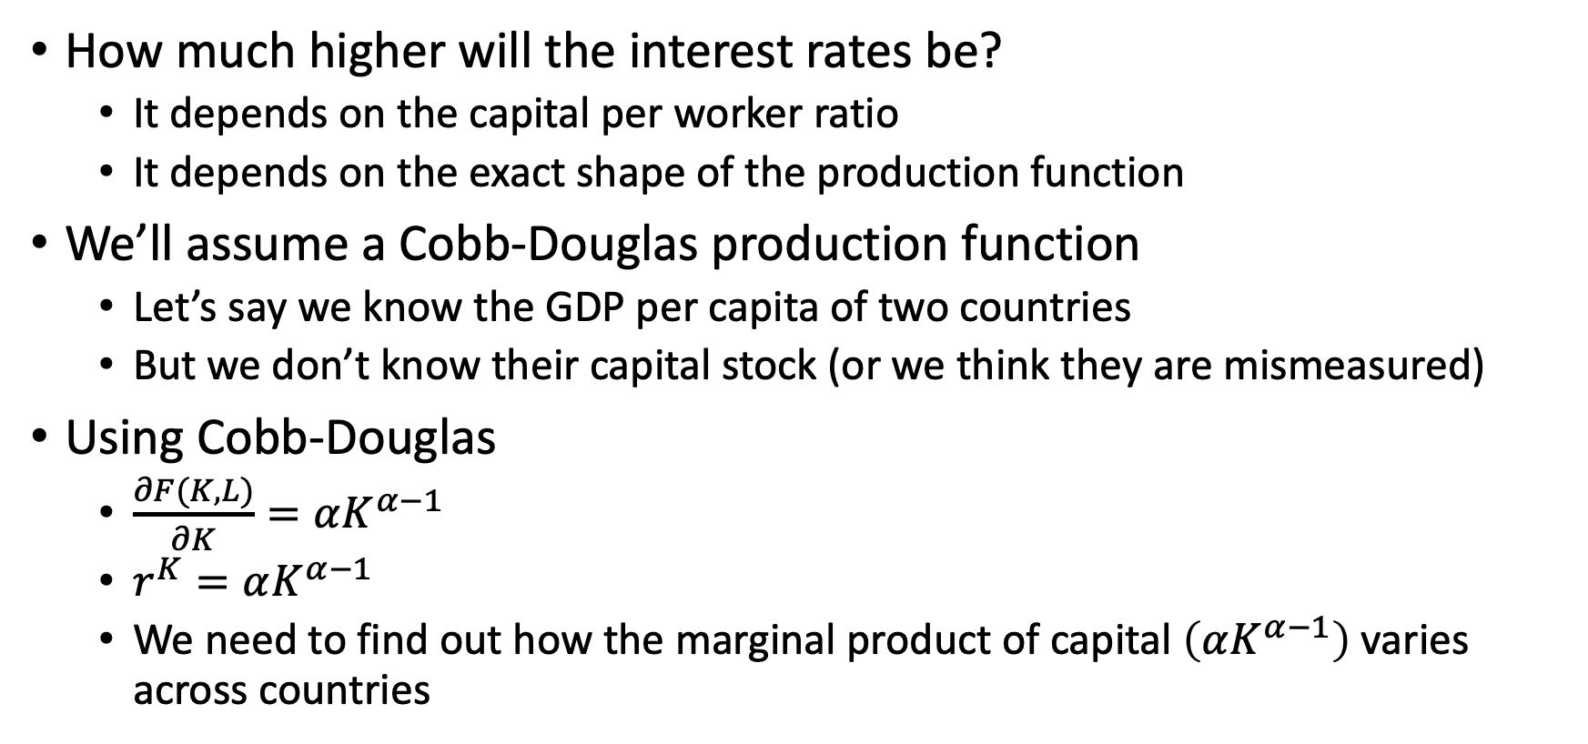
Capital Accumulation Hypothesis: Interest Rates and Capital Flows
How much higher will the interest rates be?
It depends on the capital per worker ratio
It depends on the exact shape of the production function
We’ll assume a Cobb-Douglas production function
Let’s say we know the GDP per capita of two countries
But we don’t know their capital stock (or we think they are mismeasured)
Using Cobb-Douglas
$\frac{∂F(K,L)}{∂K}=αK^{α−1}$
$r^{K}=αK^{α−1}$
We need to find out how the marginal product of capital $\left(αK^{α−1}\right)$ varies across countries

Slide 44
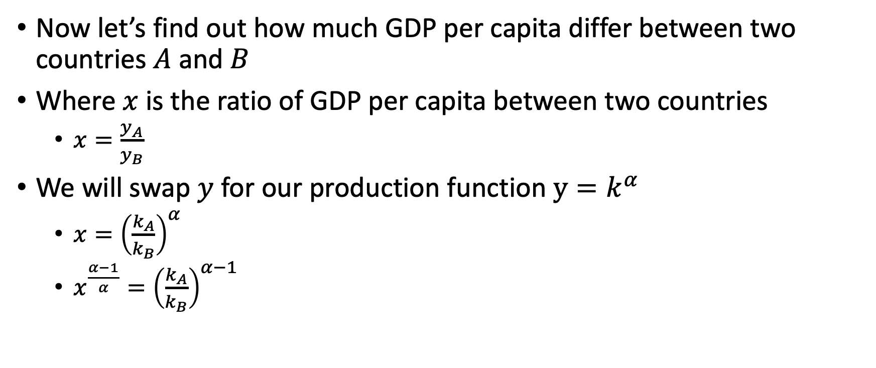
Capital Accumulation Hypothesis: Interest Rates and Capital Flows
Now let’s find out how much GDP per capita differ between two countries $A$ and $B$
Where $x$ is the ratio of GDP per capita between two countries
$x=\frac{y_{A}}{y_{B}}$
We will swap $y$ for our production function $y=k^{α}$
$x={\left(\frac{k_{A}}{k_{B}}\right)}^{α}$
$x^{\frac{α−1}{α}}={\left(\frac{k_{A}}{k_{B}}\right)}^{α−1}$

Slide 45
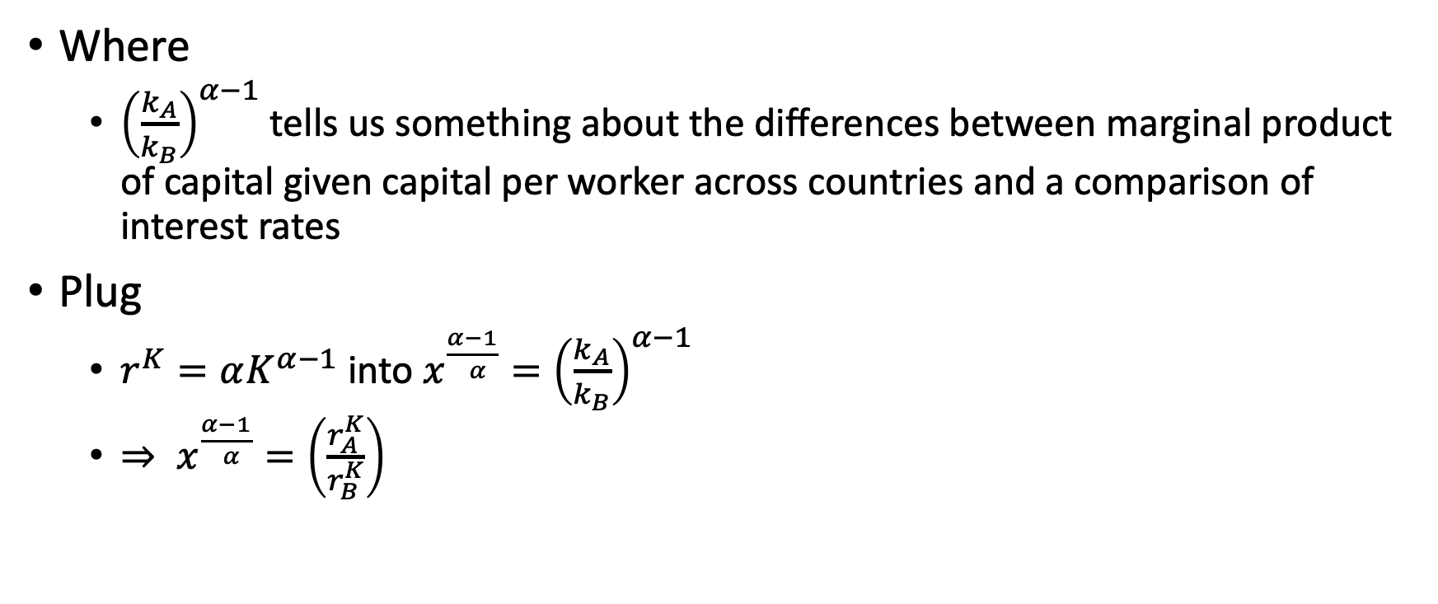
Capital Accumulation Hypothesis: Interest Rates and Capital Flows
Where
${\left(\frac{k_{A}}{k_{B}}\right)}^{α−1}$ tells us something about the differences between marginal product of capital given capital per worker across countries and a comparison of interest rates
Plug
$r^{K}=αK^{α−1}$ into $x^{\frac{α−1}{ α}}={\left(\frac{k_{A}}{k_{B}}\right)}^{α−1}$
$⇒ x^{\frac{α−1}{ α}}=\left(\frac{r_{A}^{K}}{r_{B}^{K}}\right)$

Slide 46
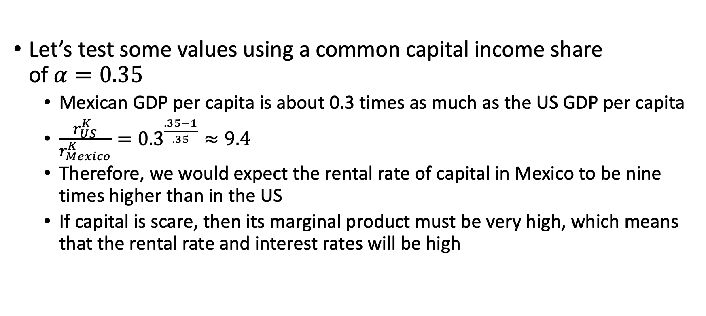
Capital Accumulation Hypothesis: Interest Rates and Capital Flows
Let’s test some values using a common capital income share of $α=0.35$
Mexican GDP per capita is about 0.3 times as much as the US GDP per capita
$\frac{r_{US}^{K}}{r_{Mexico}^{K}}={0.3}^{\frac{.35−1}{.35}}≈9.4$
Therefore, we would expect the rental rate of capital in Mexico to be nine times higher than in the US
If capital is scare, then its marginal product must be very high, which means that the rental rate and interest rates will be high

Slide 47
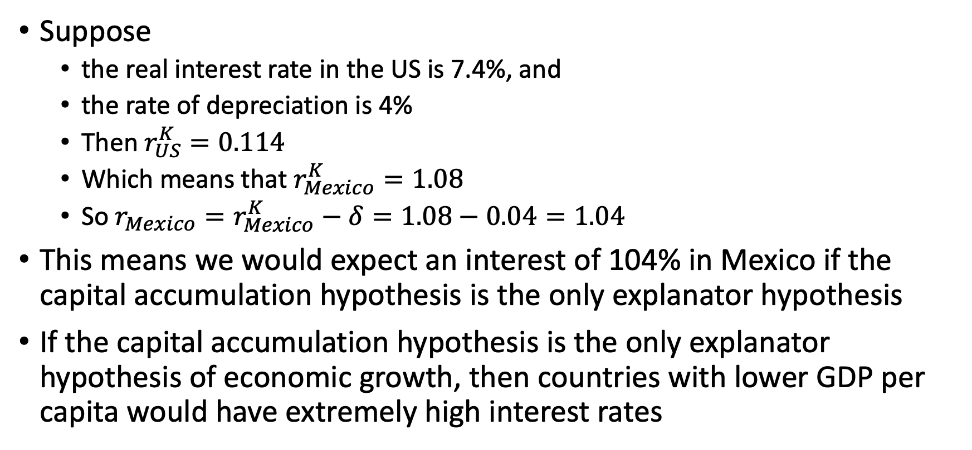
Capital Accumulation Hypothesis: Interest Rates and Capital Flows
Suppose
the real interest rate in the US is 7.4%, and
the rate of depreciation is 4%
Then $r_{US}^{K}=0.114$
Which means that $r_{Mexico}^{K}=1.08$
So $r_{Mexico}=r_{Mexico}^{K}−δ=1.08−0.04=1.04$
This means we would expect an interest of 104% in Mexico if the capital accumulation hypothesis is the only explanator hypothesis
If the capital accumulation hypothesis is the only explanator hypothesis of economic growth, then countries with lower GDP per capita would have extremely high interest rates

Slide 48
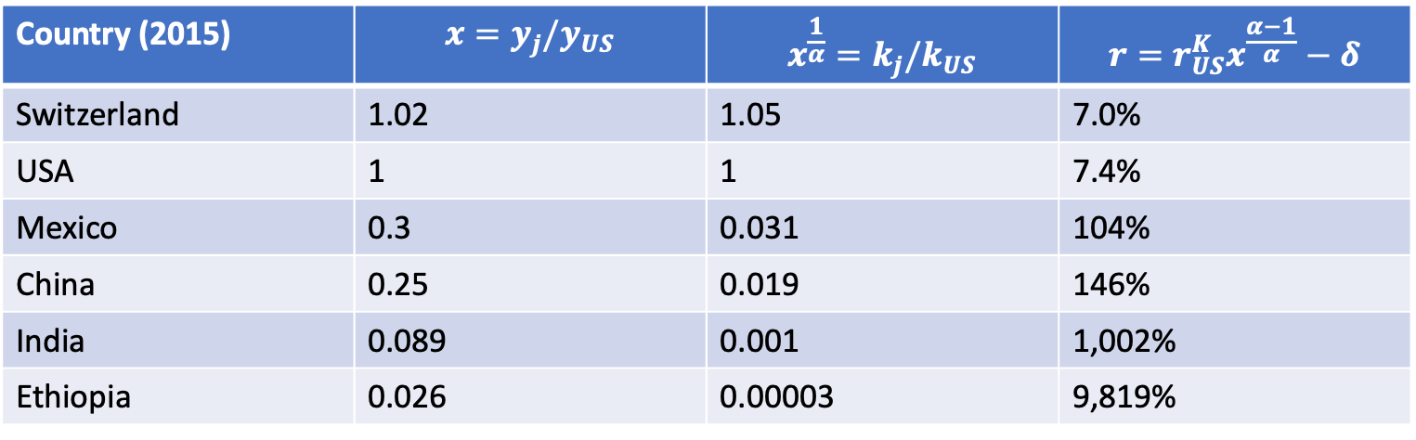
Capital Accumulation Hypothesis: Interest Rates and Capital Flows
Lucas (1990) explained that is this were true and low GDP per capita countries had extremely high interest rates
The incentives for investors in higher GDP per capita countries to invest in low GDP per capita countries would be huge. This reduces the likelihood that the capital accumulation hypothesis is the only explanator hypothesis
Note: we are assuming no risk and a closed economy with the Solow model
Country (2015) | $$x=y_{j}/y_{US}$$ | $$x^{\frac{1}{α}}=k_{j}/k_{US}$$ | $$r=r_{US}^{K}x^{\frac{α−1}{α}}−δ$$
Switzerland | 1.02 | 1.05 | 7.0%
USA | 1 | 1 | 7.4%
Mexico | 0.3 | 0.031 | 104%
China | 0.25 | 0.019 | 146%
India | 0.089 | 0.001 | 1,002%
Ethiopia | 0.026 | 0.00003 | 9,819%

Slide 49
Growth Accounting

Slide 50
Growth Accounting
Why is there economic growth and why does it vary by country?
Is it because of capital accumulation?
Is it because more people working?
Is it because of technological progress?

Slide 51
Growth Accounting
A technique called growth accounting can be used to measure the contribution of each factor
Measure how much capital and labor have changed
Figure out how much change in output we should expect from these changes
We are combining theory and measurement
Attribute all changes in output that cannot be accounted for by changes in capital and labor to changes in productivity

Slide 52
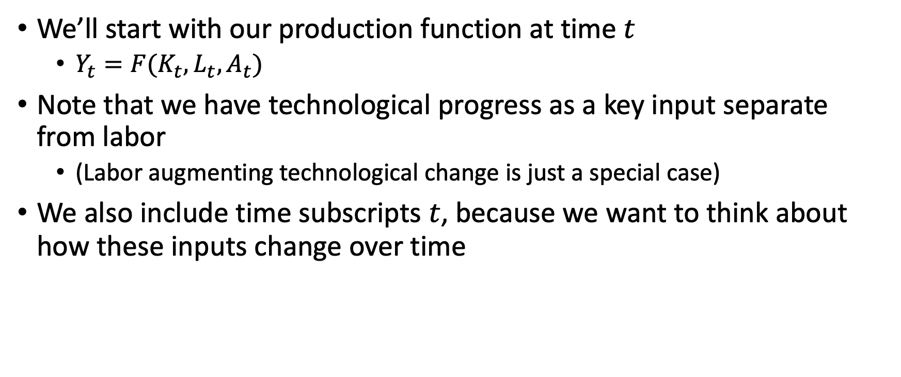
Growth Accounting
We’ll start with our production function at time $t$
$Y_{t}=F(K_{t},L_{t},A_{t})$
Note that we have technological progress as a key input separate from labor
(Labor augmenting technological change is just a special case)
We also include time subscripts $t$, because we want to think about how these inputs change over time

Slide 53
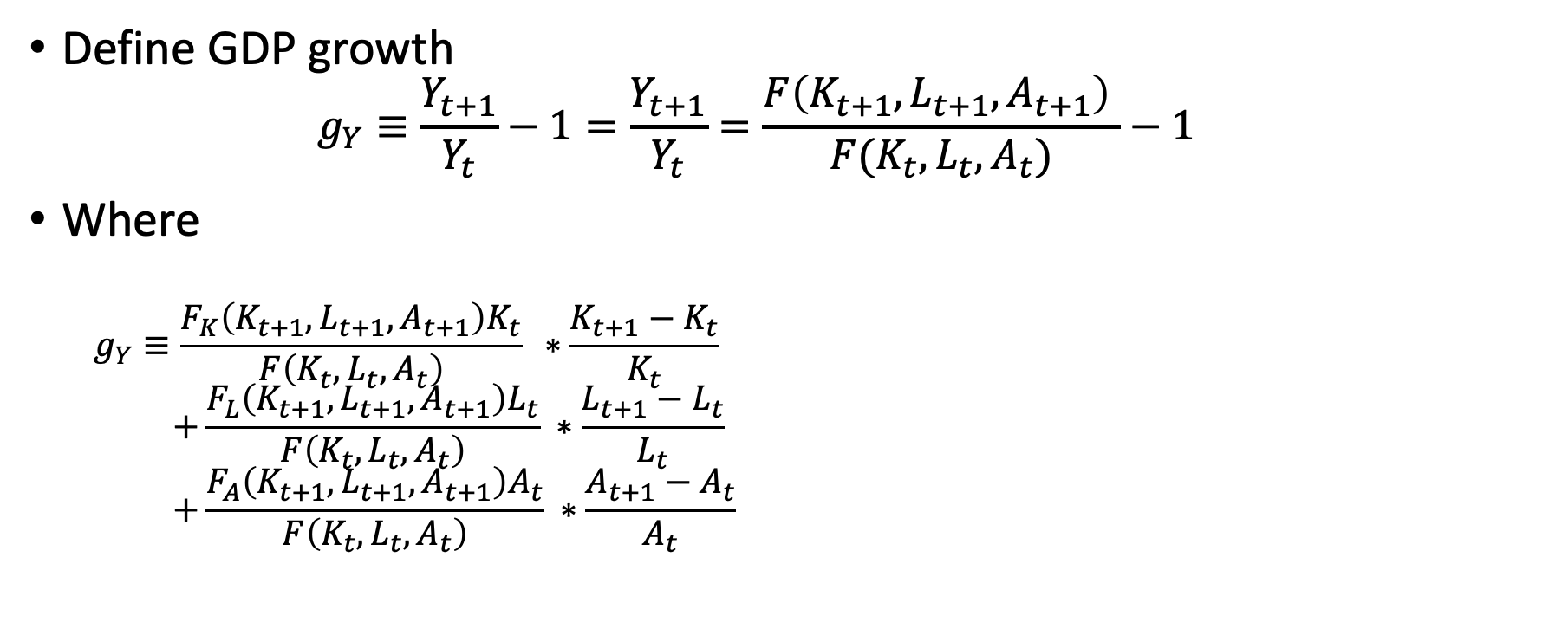
Growth Accounting
Define GDP growth
$$g_{Y}≡\frac{Y_{t+1}}{Y_{t}}−1=\frac{Y_{t+1}}{Y_{t}}=\frac{F\left(K_{t+1},L_{t+1},A_{t+1}\right) }{F(K_{t},L_{t},A_{t})}−1$$
Where
$$g_{Y}≡\frac{F_{K}\left(K_{t+1},L_{t+1},A_{t+1}\right)K_{t}}{F\left(K_{t},L_{t},A_{t}\right)} ∗\frac{K_{t+1}−K_{t}}{K_{t}} \\ +\frac{F_{L}\left(K_{t+1},L_{t+1},A_{t+1}\right)L_{t}}{F\left(K_{t},L_{t},A_{t}\right)} ∗\frac{L_{t+1}−L_{t}}{L_{t}} \\ +\frac{F_{A}\left(K_{t+1},L_{t+1},A_{t+1}\right)A_{t}}{F\left(K_{t},L_{t},A_{t}\right)} ∗\frac{A_{t+1}−A_{t}}{A_{t}}$$

Slide 54
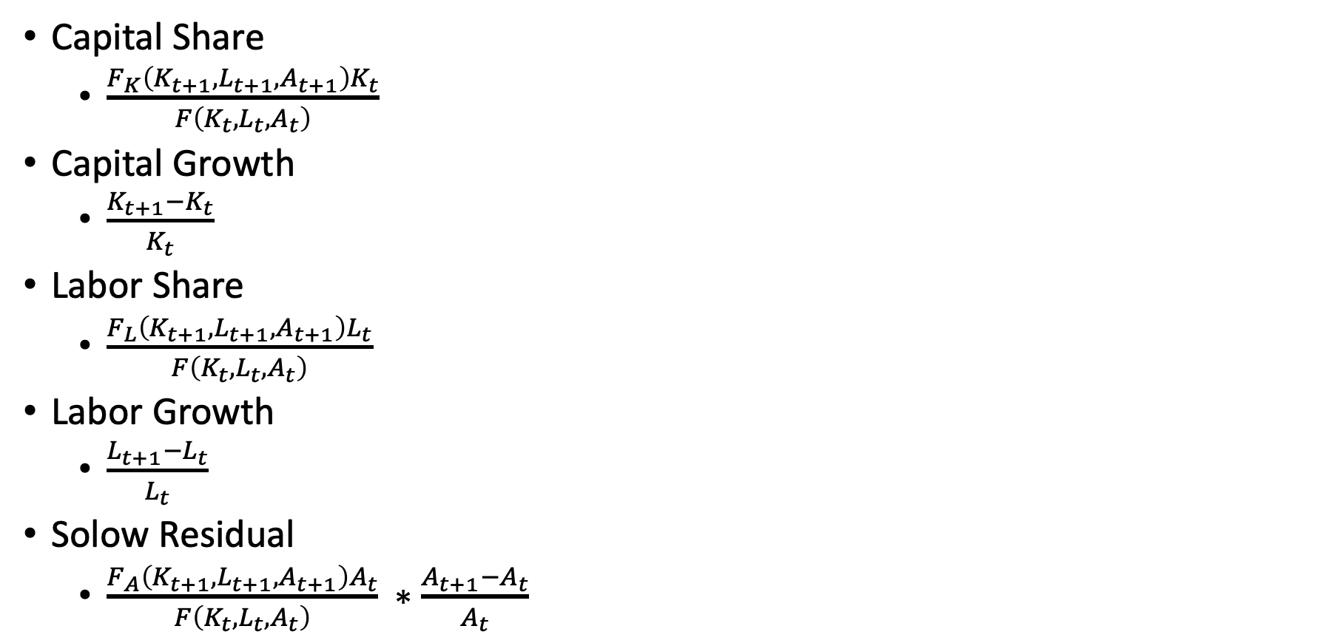
Growth Accounting
Capital Share
$\frac{F_{K}\left(K_{t+1},L_{t+1},A_{t+1}\right)K_{t}}{F\left(K_{t},L_{t},A_{t}\right)}$
Capital Growth
$\frac{K_{t+1}−K_{t}}{K_{t}}$
Labor Share
$\frac{F_{L}\left(K_{t+1},L_{t+1},A_{t+1}\right)L_{t}}{F\left(K_{t},L_{t},A_{t}\right)}$
Labor Growth
$\frac{L_{t+1}−L_{t}}{L_{t}}$
Solow Residual
$\frac{F_{A}\left(K_{t+1},L_{t+1},A_{t+1}\right)A_{t}}{F\left(K_{t},L_{t},A_{t}\right)} ∗\frac{A_{t+1}−A_{t}}{A_{t}}$

Slide 55
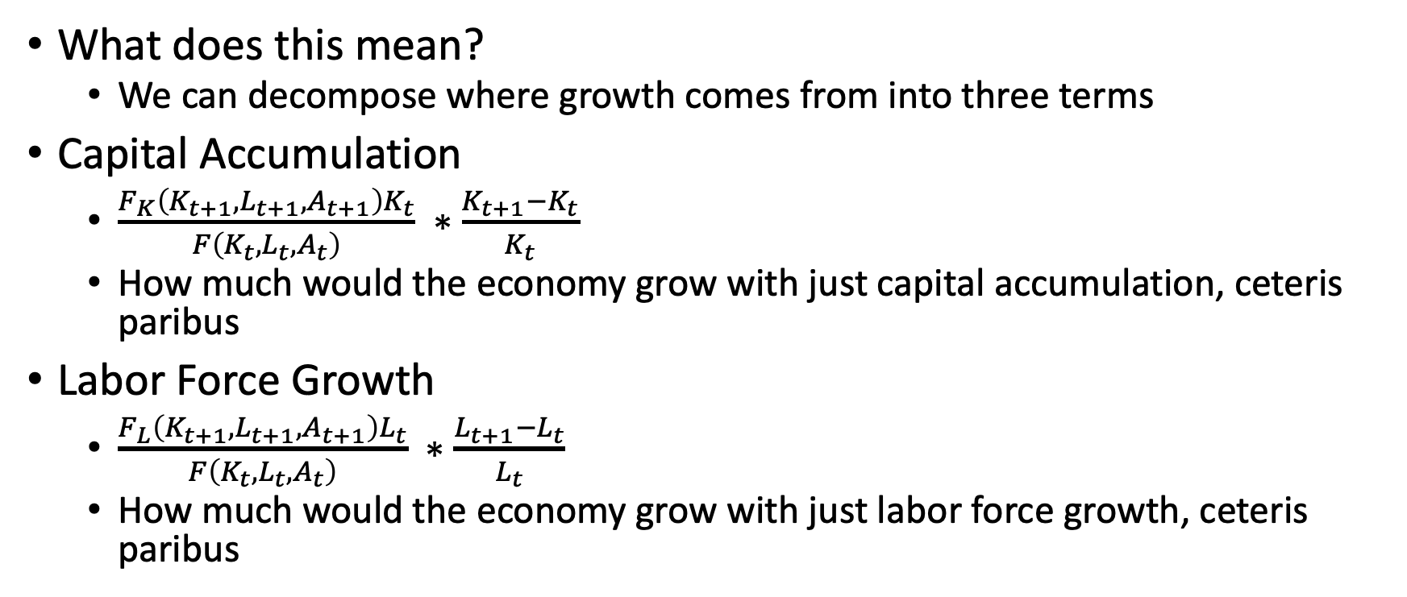
Growth Accounting
What does this mean?
We can decompose where growth comes from into three terms
Capital Accumulation
$\frac{F_{K}\left(K_{t+1},L_{t+1},A_{t+1}\right)K_{t}}{F\left(K_{t},L_{t},A_{t}\right)} ∗\frac{K_{t+1}−K_{t}}{K_{t}}$
How much would the economy grow with just capital accumulation, ceteris paribus
Labor Force Growth
$\frac{F_{L}\left(K_{t+1},L_{t+1},A_{t+1}\right)L_{t}}{F\left(K_{t},L_{t},A_{t}\right)} ∗\frac{L_{t+1}−L_{t}}{L_{t}}$
How much would the economy grow with just labor force growth, ceteris paribus

Slide 56
Growth Accounting
Intuition for capital and labor growth
More capital will increase GDP by an amount equal to its marginal product of capital, ceteris paribus
More labor will increase GDP by an amount equal to its marginal product of labor, ceteris paribus
We can see the importance of marginal products for each factor’s share of GDP
Measurement of capital and labor growth
Measurement of labor share and growth is fairly easy with quality labor market data
Measuring capital share and growth is trickier. We need to measure capital stock, depreciation, investment, and rental rates

Slide 57
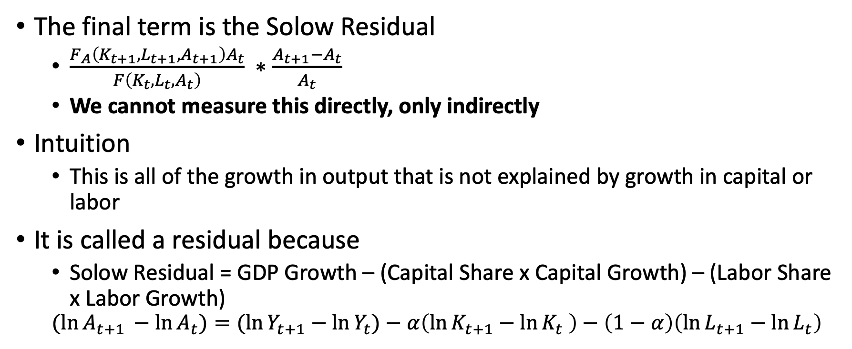
Growth Accounting
The final term is the Solow Residual
$\frac{F_{A}\left(K_{t+1},L_{t+1},A_{t+1}\right)A_{t}}{F\left(K_{t},L_{t},A_{t}\right)} ∗\frac{A_{t+1}−A_{t}}{A_{t}}$
We cannot measure this directly, only indirectly
Intuition
This is all of the growth in output that is not explained by growth in capital or labor
It is called a residual because
Solow Residual = GDP Growth – (Capital Share x Capital Growth) – (Labor Share x Labor Growth)
$$(ln{A_{t+1 }−\ln{A_{t})=(\ln{Y_{t+1}−\ln{Y_{t})−α\left(\ln{K_{t+1}−\ln{K_{t}} }\right)−\left(1−α\right)\left(\ln{L_{t+1}}−\ln{L_{t}}\right)}}}}$$

Slide 58
Growth Accounting
Total Factor Productivity (TFP)
The Solow Residual is usually referred to as Total Factor Productivity (or sometimes Multifactor Productivity)
It includes everything that is not explained by growth in capital and labor,
Growth in productivity is the key to sustained long-run economic growth
Takeaway:
There are many different sources of total factor productivity growth

Slide 59
Growth Accounting
Where does TFP comes from?
Human Capital
Geography
Institutions
Resource allocation and misallocation
Climate
Physical infrastructure
Free Trade
Management Practices
Technological change

Slide 60
Growth Accounting
An example of technological change and TFP in economic growth: Economic growth in the Soviet Union between 1928 and 1966
Growth was very strong of 5.4% (which was less than official soviet estimates of 9%, but still strong) and was converging with the US
The source of the growth was capital accumulation and investment was 8% of GDP in 1929 and 31% of GDP near 1966
As we discussed, the marginal product of capital gets closer to zero when there is too much capital and not enough labor
TFP was fairly unremarkable, so high growth cannot continue in the long run; Soviet economic performance in the 1970s and 1980s stagnated
Also we need to note that factors shares were not determined by market forces (Resource Misallocation)
GDP Growth | Capital Share | Capital Growth | Labor Share | Labor Growth | Residual
5.4% | 0.4 | 6.5% | 0.6 | 2.8% | 1.1%

Slide 61
Sources of Total Factor Productivity (TFP)

Slide 62
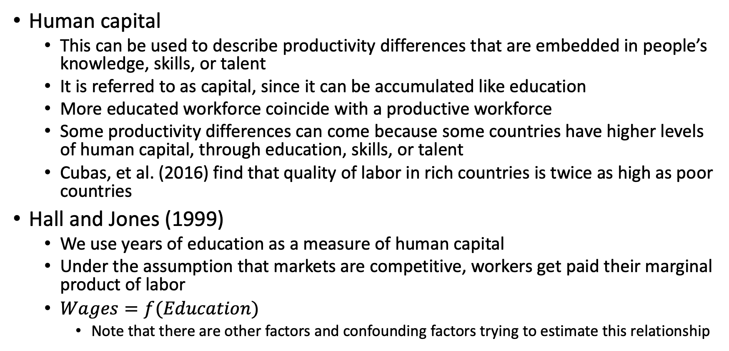
Sources of TFP: Human Capital
Human capital
This can be used to describe productivity differences that are embedded in people’s knowledge, skills, or talent
It is referred to as capital, since it can be accumulated like education
More educated workforce coincide with a productive workforce
Some productivity differences can come because some countries have higher levels of human capital, through education, skills, or talent
Cubas, et al. (2016) find that quality of labor in rich countries is twice as high as poor countries
Hall and Jones (1999)
We use years of education as a measure of human capital
Under the assumption that markets are competitive, workers get paid their marginal product of labor
$Wages=f(Education)$
Note that there are other factors and confounding factors trying to estimate this relationship

Slide 63
Sources of TFP: Human Capital
We’ll predict GDP per capita growth similar similar to our exercise earlier, but we’ll use years of education and capital per worker to predict GDP per capita
Compared to earlier, this model does better at predicting GDP per capita, but there are still gaps in predicted and actual between low and high GDP per capita countries

Slide 64
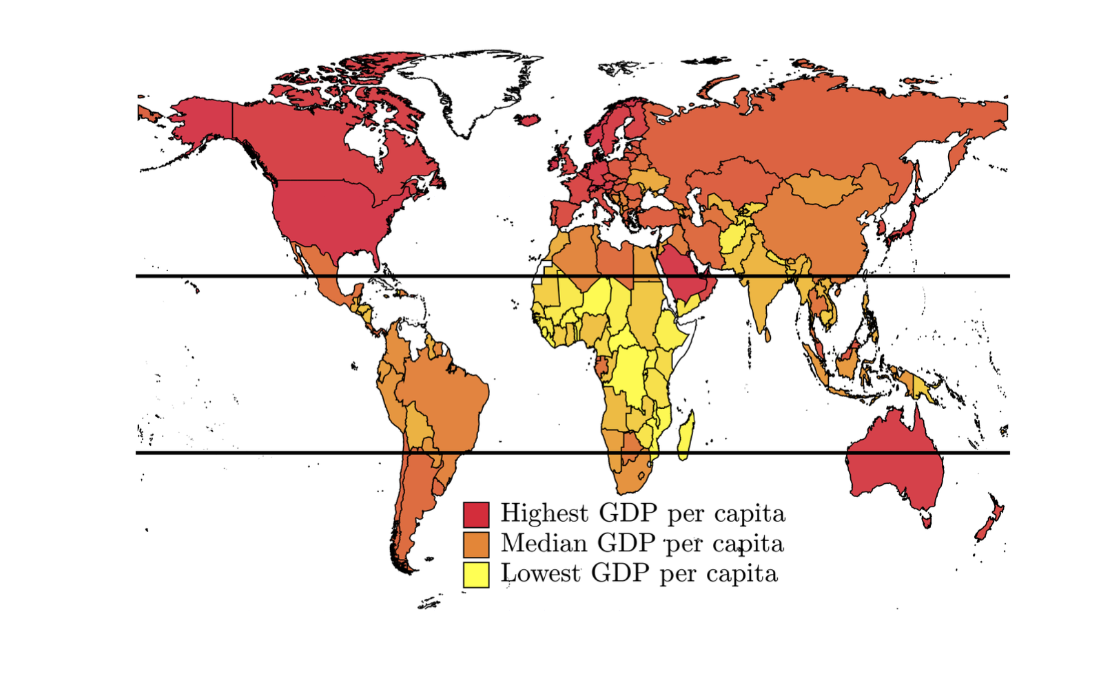
Sources of TFP: Geography and Climate
Geography can be linked to productivity
Trade specialization leads to productivity gains (e.g.: Baltimore, where the Piedmont meets the Patapsco and Chesapeake Bay)
Some countries have an endowment of waterways (e.g.: Mississippi, Ohio rivers to transport goods)
Some geographies make trade harder, such as mountainous terrains (Afghanistan, or locally West Virigina)

Slide 65
Sources of TFP: Geography and Climate
Hot climates are also negatively correlated with GDP per capita
Potential source is disease, where diseases like malaria thrive in hot climates
Another potential source is hot, muggy climates reduce productivity because it is too hot to work (Conversely, it is too cold for construction in the winter)
There is a correlation between the South’s (US) adoption of A/C and increases in productivity

Slide 66
Sources of Growth: Institutions
Institutions
This is referred to as the political and social conditions of countries
Democracy, adherence to the rule of law, political transparency, respect for property rights, lack of corruption, trade links
Property rights
When there is well-defined, well-protected property rights, innovation is encouraged
With little property rights, the incentives to innovate are much weaker
There is a very strong correlation between TFP growth and institutions
Countries with stronger and more democratic institutions are typically richer
Or, could it be that as countries get richer, they become more democratic?
Acemoglu, Johnson, and Robinson (2002)
Examined the relationship between colonist mortality and risk of expropriation
Countries that were exposed to extractive institutions had stronger weak growth

Slide 67

Sources of Growth: Free Trade
Countries with freer trade typically have higher productivity
It allows for greater specialization
It allows for positive knowledge spillovers (externalities) from countries with higher GDP per capita to countries with lower GDP per capita
Sachs and Warner (1995) find that relatively open economies grow much faster than relatively closed ones
This meme, but unironically
Free trade increases productivity

Slide 68
Sources of TFP: Finance and Physical Infrastructure
Finance
Robust financial systems encourage innovation which increases productivity
A robust financial system intermediates between savers and borrowers
Without one, it would be hard for an individual or a business to implement large scale projects that require financial support due to a lack of funds
Physical Infrastructure
Countries with robust physical infrastructure, such as roads, bridges, water treatment systems, railways, airports, electricity generation, etc. tend to be more productive than countries with poor physical infrastructure
Good physical infrastructure encourages the flow of goods, services, people, and capital that results in productivity gains

Slide 69
Sources of TFP: Resource Allocation and Misallocation
Resource misallocation is a major hindrance to productivity
Typically countries with low GDP per capita get less output out of capital and labor because they don’t put them to good use
To get the most out of capital and labor, they should be allocated to where their marginal products are highest
Sources of misallocation
Barriers to entry and entry regulation
Lack of credit
Restrictions on foreign investment
Monopoly rights
Uneven taxation or regulation across firms
Corruption
Discrimination

Slide 70
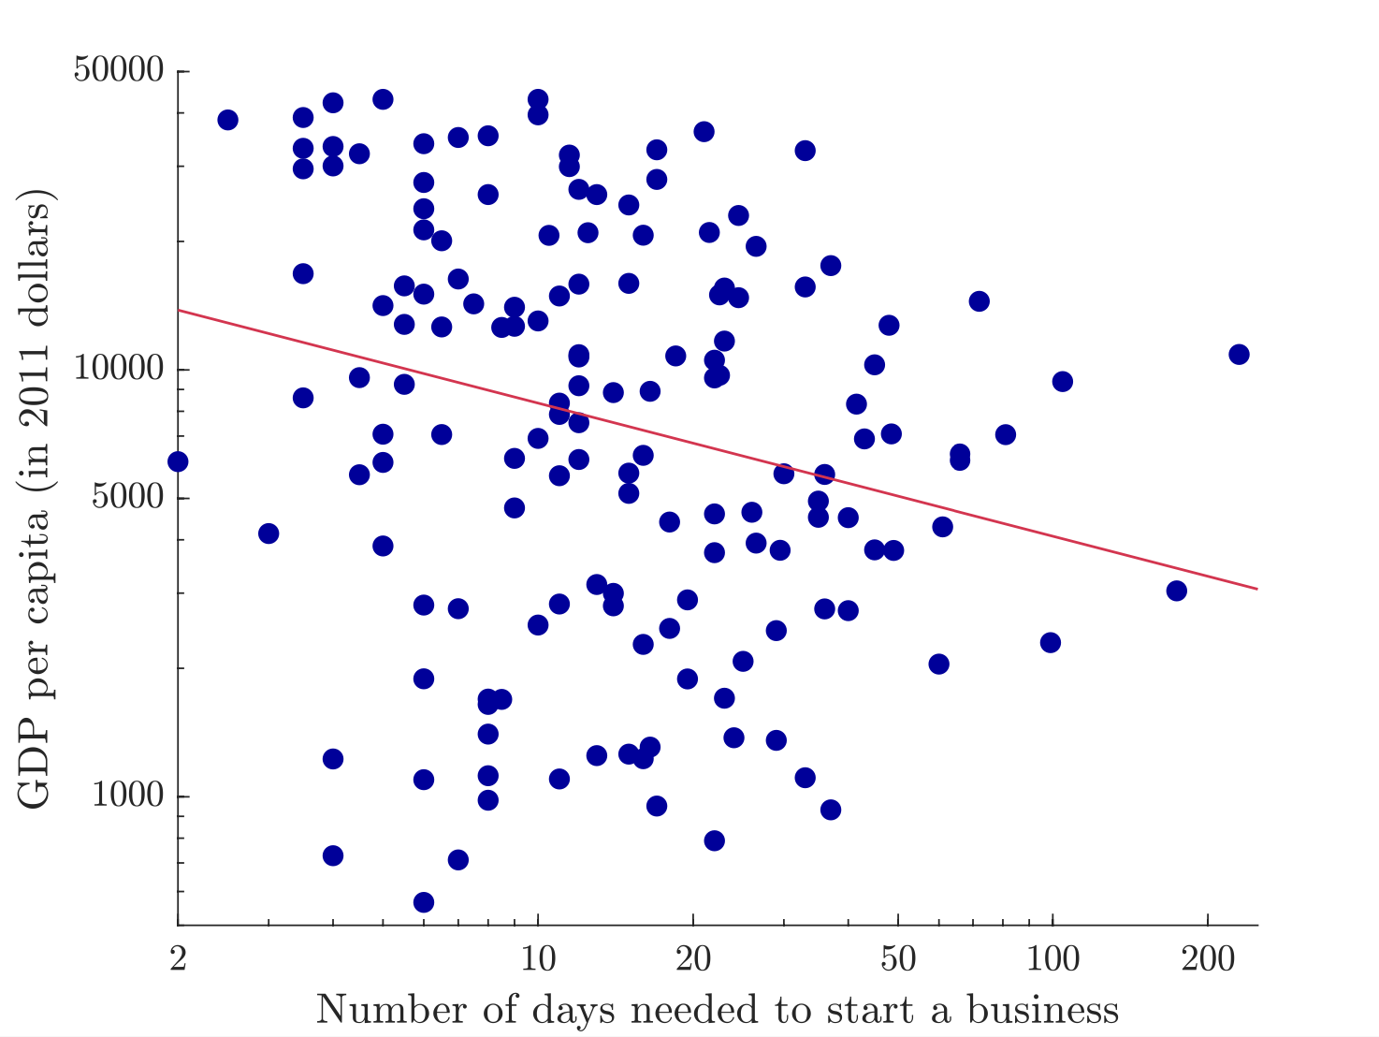
Sources of TFP: Resource Allocation and Misallocation
Entry regulation is one potential source of resource misallocation
The World Bank measures requirements for starting a business in different countries, such as permits, registration delays, etc.
It is possible that barriers to entry prevent potential businesses from getting started, and capital and labor get misallocated to less productive uses
Or, it could be that countries with higher GDP per capita have speedier procedures for registering new firms for other reasons (Reminder: causal inference is hard at the macro level)

Slide 71
Sources of TFP: Resource Allocation and Misallocation
Bloom et al. (2013) survey a sample of textile firms in India
They observed a lot of variation (or heterogeneity) in in their productivity and management practices, so why were efficient firms not expanding and taking business away from less efficient firms?
Bloom found that one of the main determinants of a firm’s size is the number of male family members the owner had
They conclude that it is hard for a owner of a firm to delegate management to outsiders who are not family members
Issues: Management styles, lack of property right enforcement, and discrimination
Hsieh and Klenow (2009) estimate the dispersion in marginal product of capital and labor in manufacturing firms in China, India, and US
They estimate that if China and India reduced their degree of misallocation of capital and labor across firms to the levels observed in the US, their TFP could increase by 30%-50% and 40%-60%, respectively

Slide 72
Understanding Cross-Country Income Differences
Garin et al Chapter 7

Slide 73
Overview
Garin et al. (2021) review similar issues with understanding cross-country differences in GDP per capita
Convergence
Saving Rates
Productivity
Takeaway
Countries with low GDP per capita have low GDP per capita not because they lack capital, but because they are not as productive as countries with high GDP per capita
Productivity is the key to sustained long-run economic growth

Slide 74
Summary
We’ll just cover the summary since we covered similar material in Kurlat (even though I like the explanation in Garin et al. (2021) a bit more)
Takeaway
In the steady state, income differences across countries are driven by differences in saving rates and productivity levels, but not initial levels of capital
Outside of the steady state, capital accumulation is important for economic growth
If countries have similar saving rates and productivity levels, they will converge

Slide 75
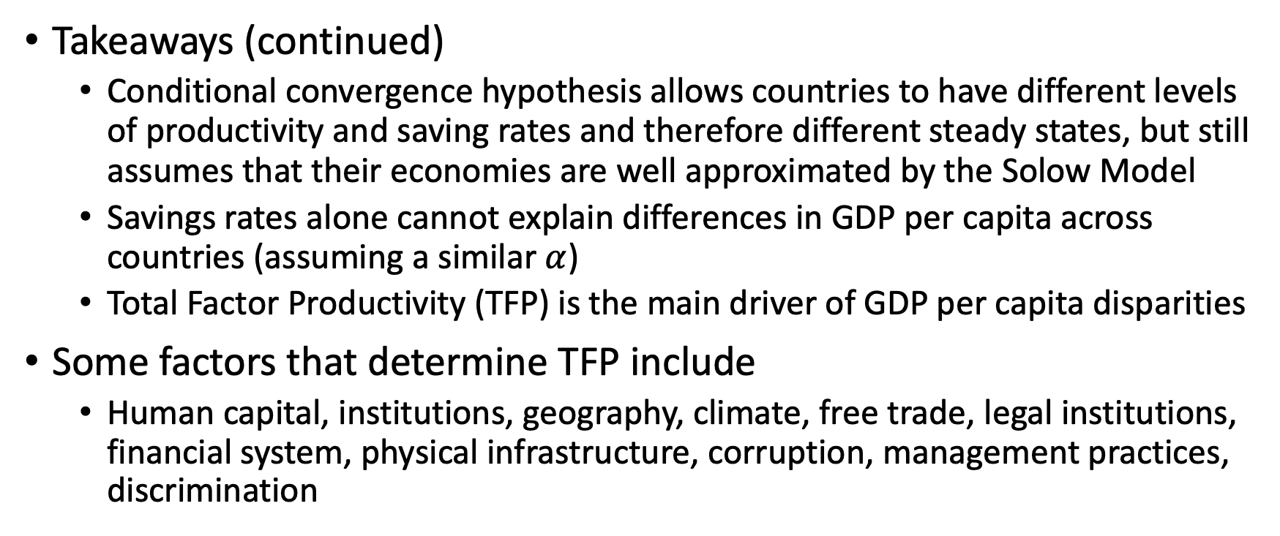
Summary
Takeaways (continued)
Conditional convergence hypothesis allows countries to have different levels of productivity and saving rates and therefore different steady states, but still assumes that their economies are well approximated by the Solow Model
Savings rates alone cannot explain differences in GDP per capita across countries (assuming a similar $α$)
Total Factor Productivity (TFP) is the main driver of GDP per capita disparities
Some factors that determine TFP include
Human capital, institutions, geography, climate, free trade, legal institutions, financial system, physical infrastructure, corruption, management practices, discrimination

Slide 76
Presentations

